Slide 1

Introduction to HTML

Slide 2
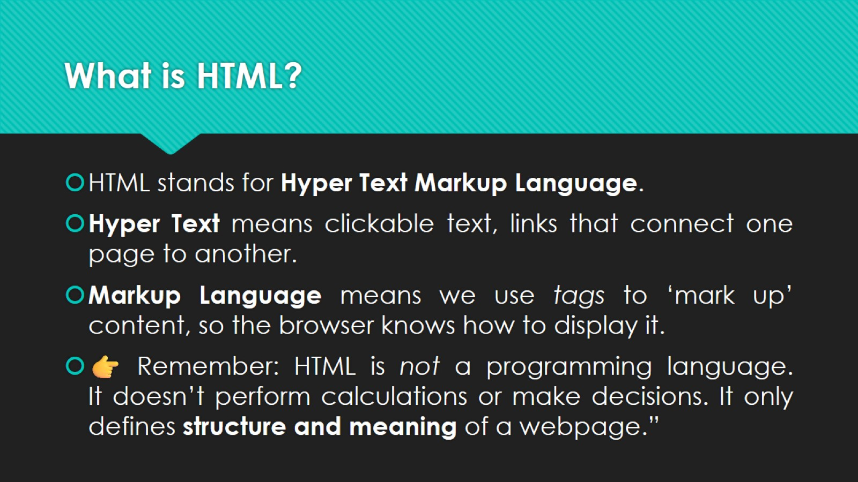
What is HTML?

Slide 3
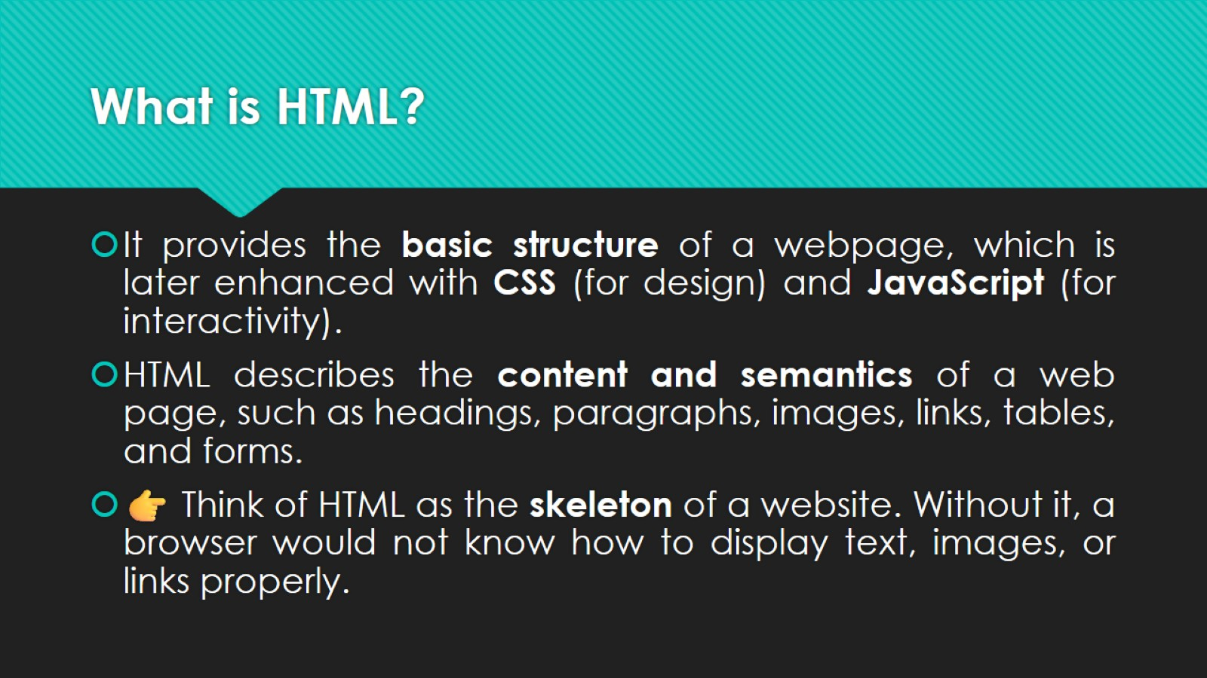
What is HTML?

Slide 4
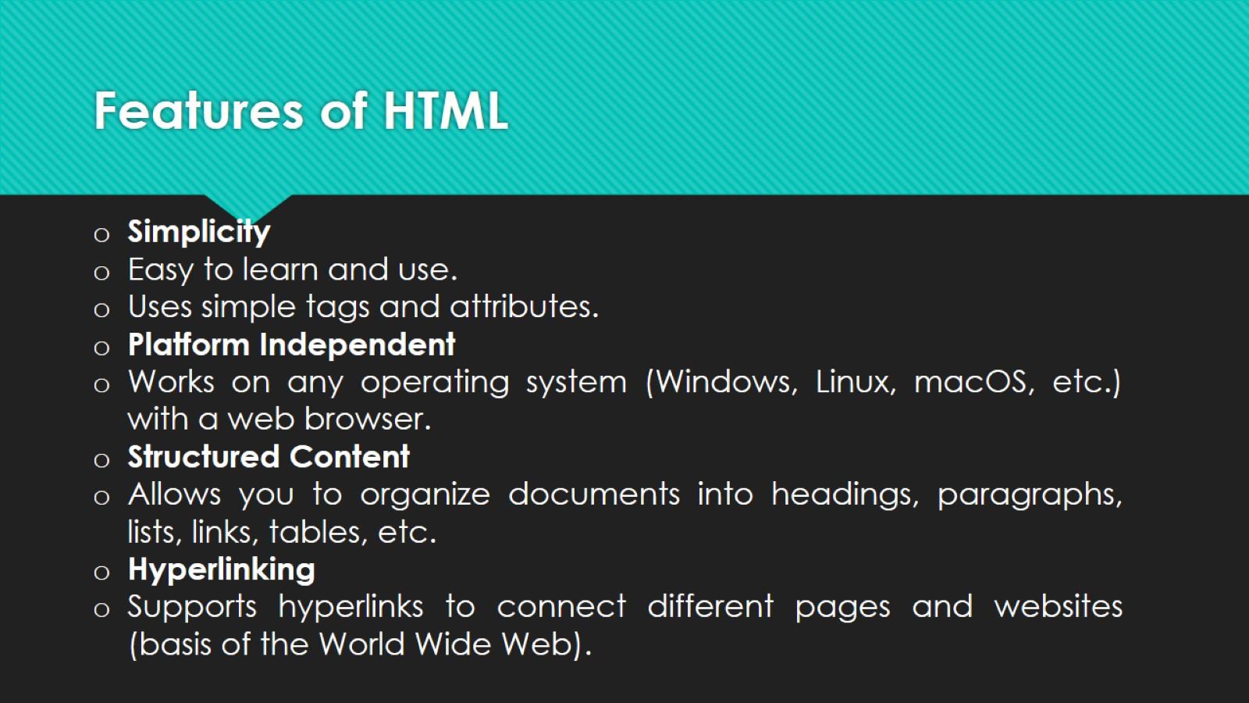
Features of HTML

Slide 5
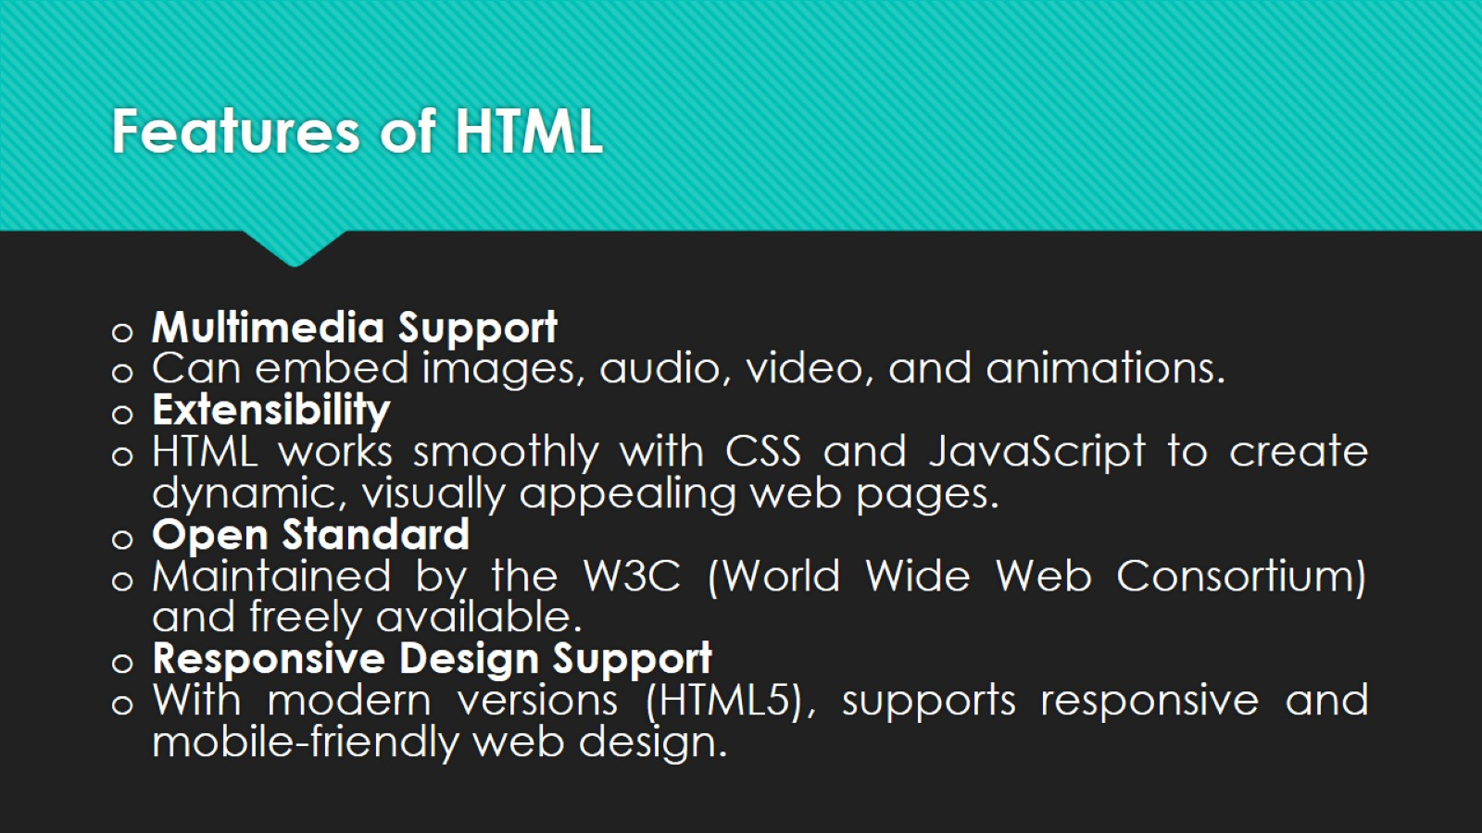
Features of HTML

Slide 6
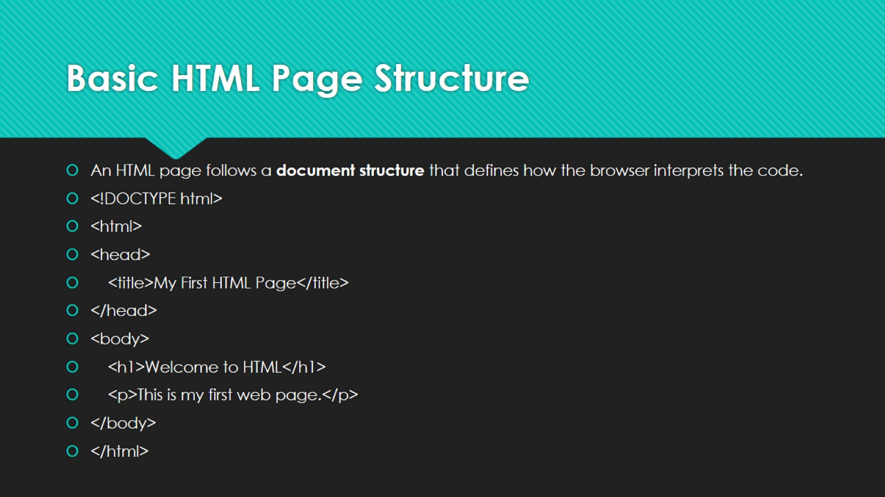
Basic HTML Page Structure

Slide 7
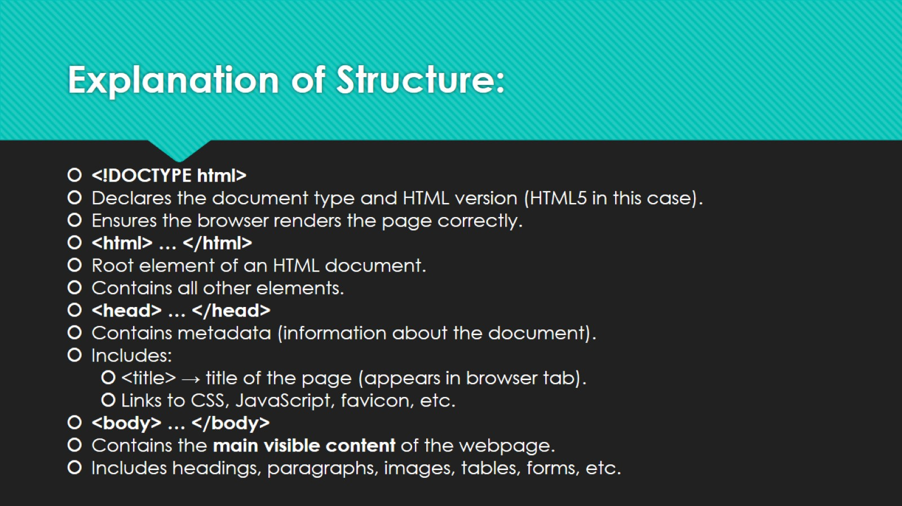
Explanation of Structure:

Slide 8
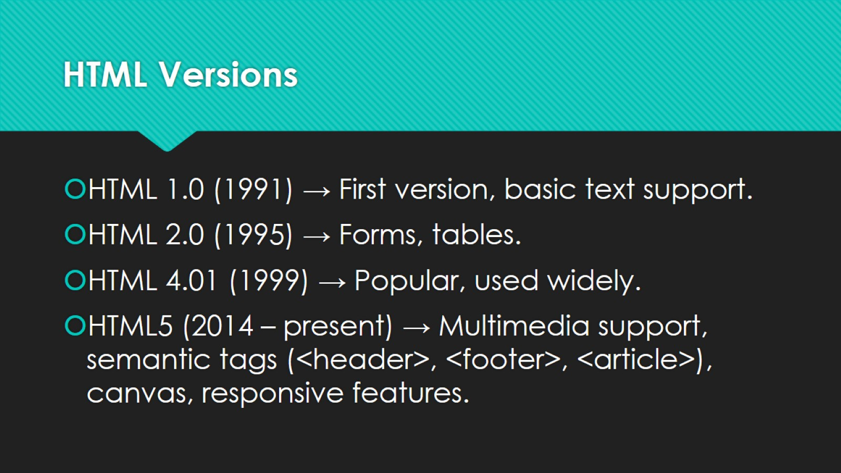
HTML Versions

Slide 9

HTML Elements (Semantic & Non-Semantic)

Slide 10
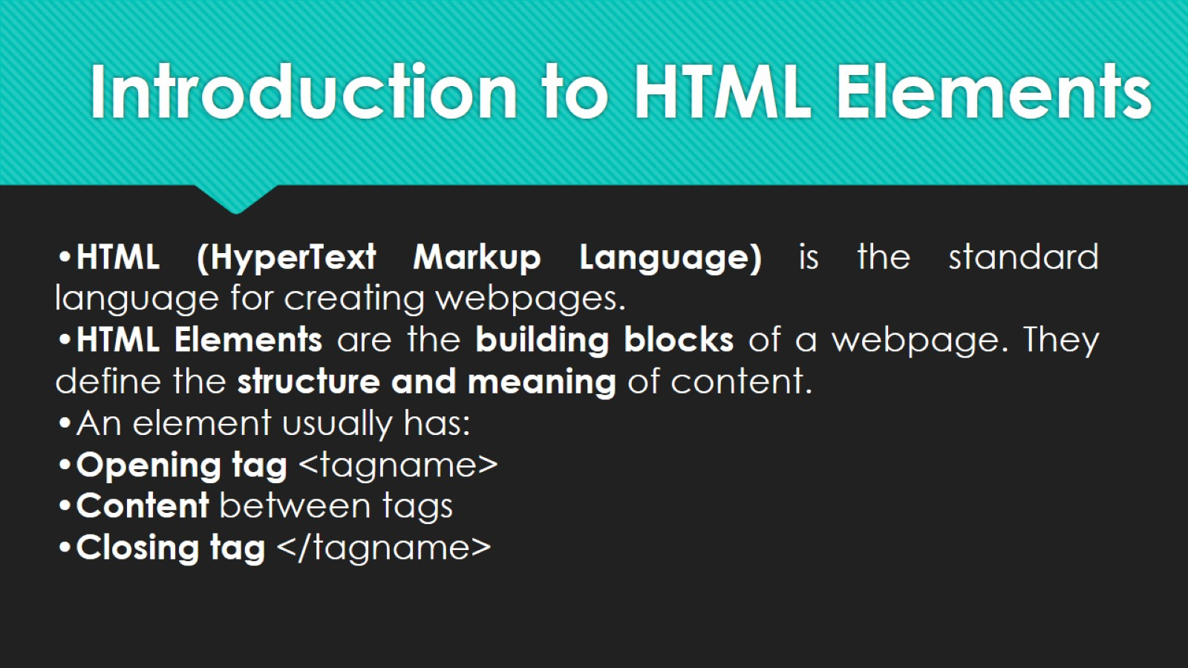
Introduction to HTML Elements

Slide 11
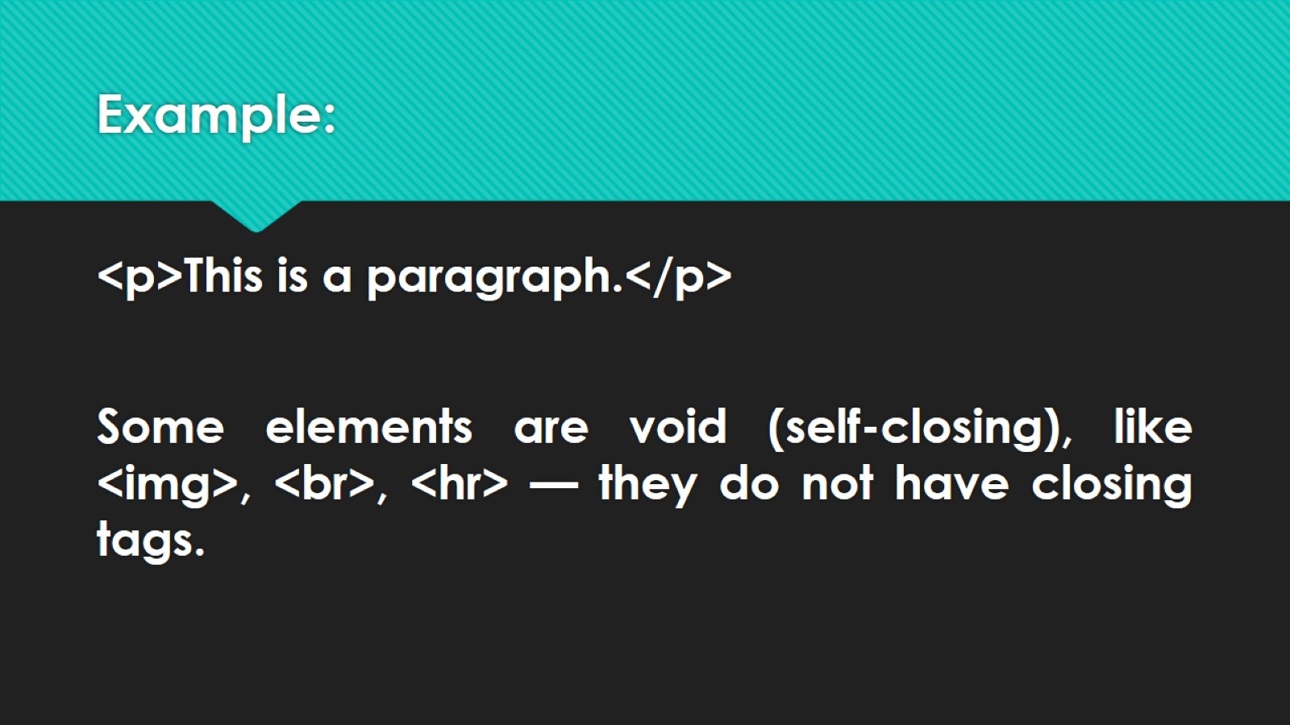
Example:

Slide 12
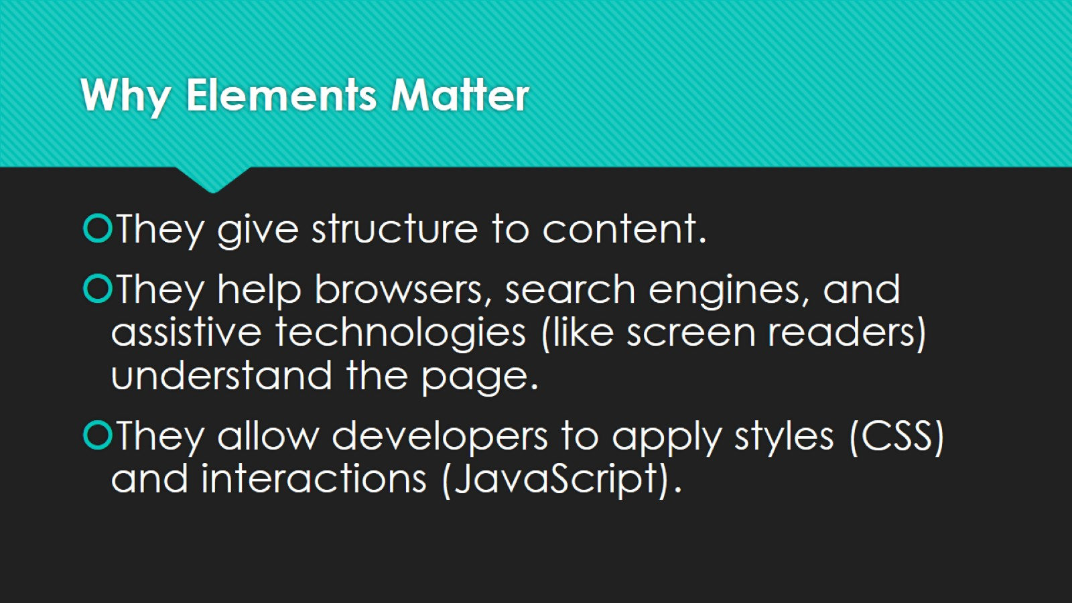
Why Elements Matter

Slide 13
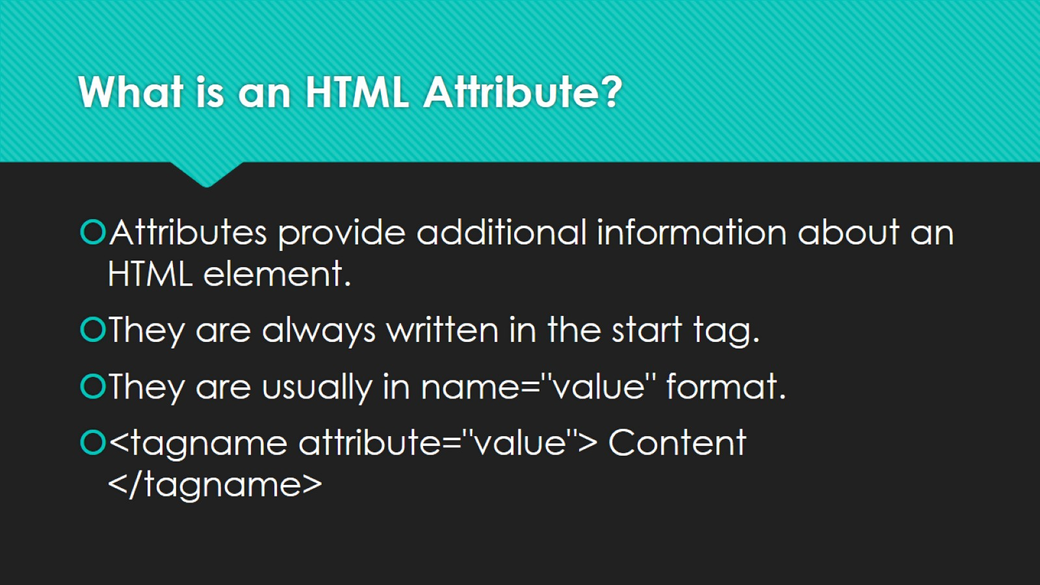
What is an HTML Attribute?

Slide 14
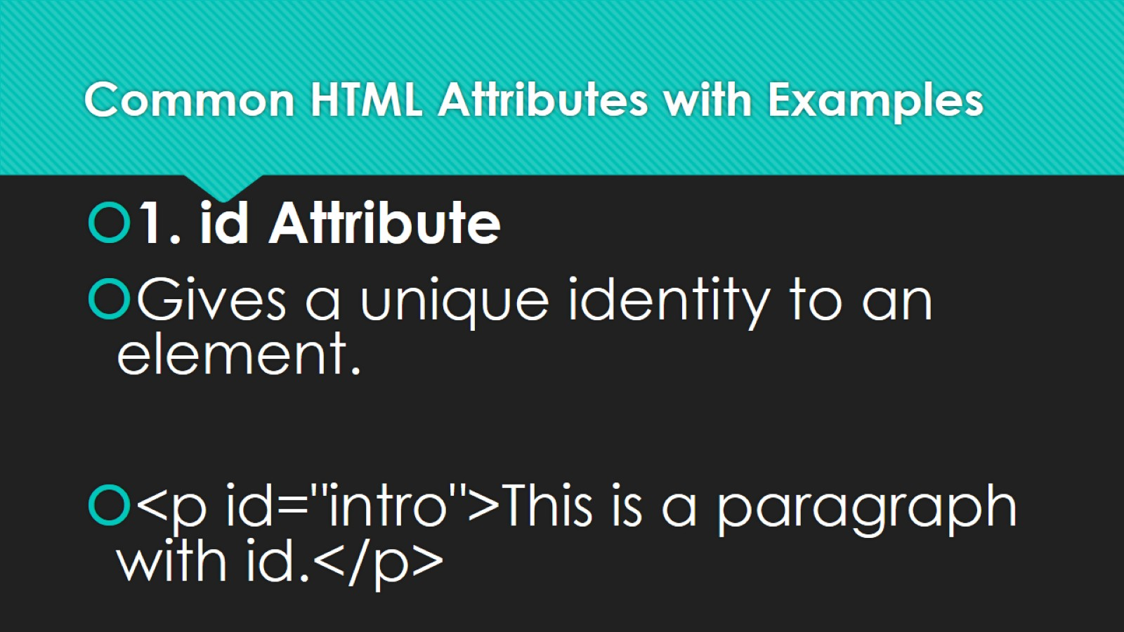
Common HTML Attributes with Examples

Slide 15
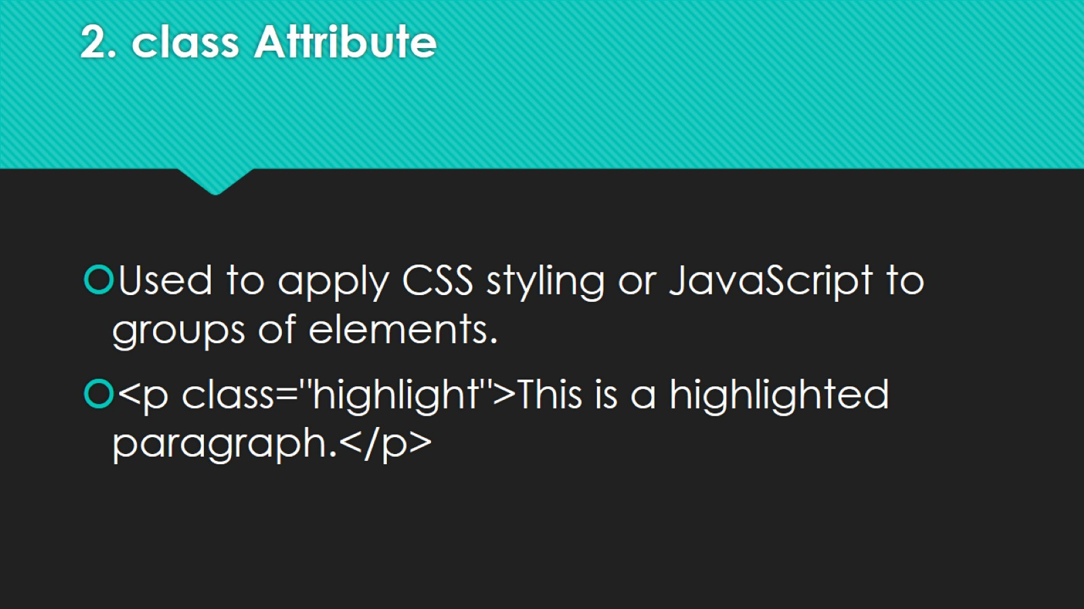
2. class Attribute

Slide 16
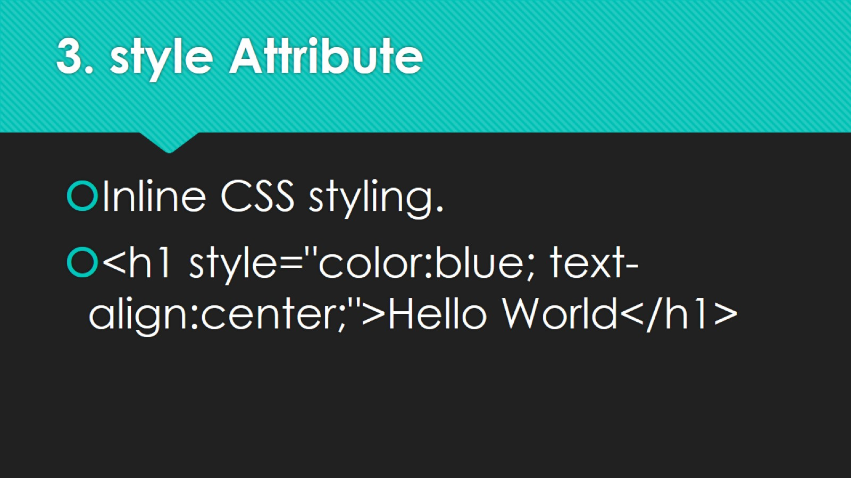
3. style Attribute

Slide 17
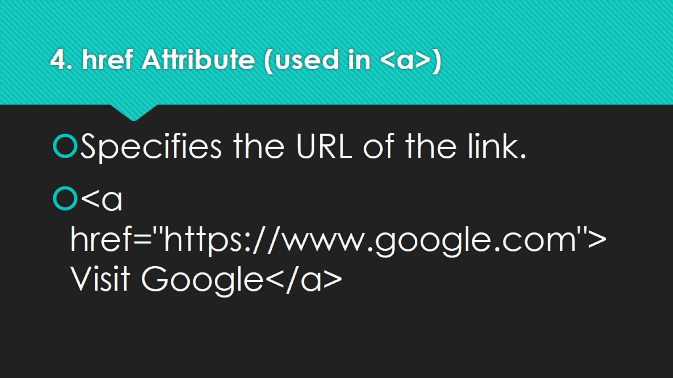
4. href Attribute (used in <a>)

Slide 18
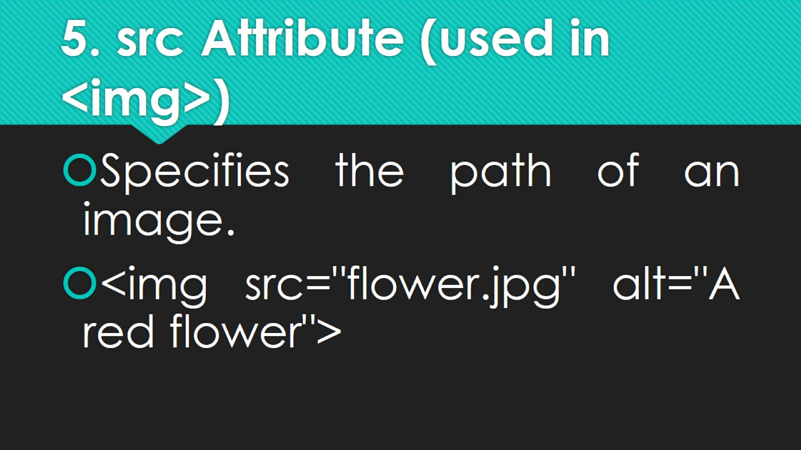
5. src Attribute (used in <img>)

Slide 19
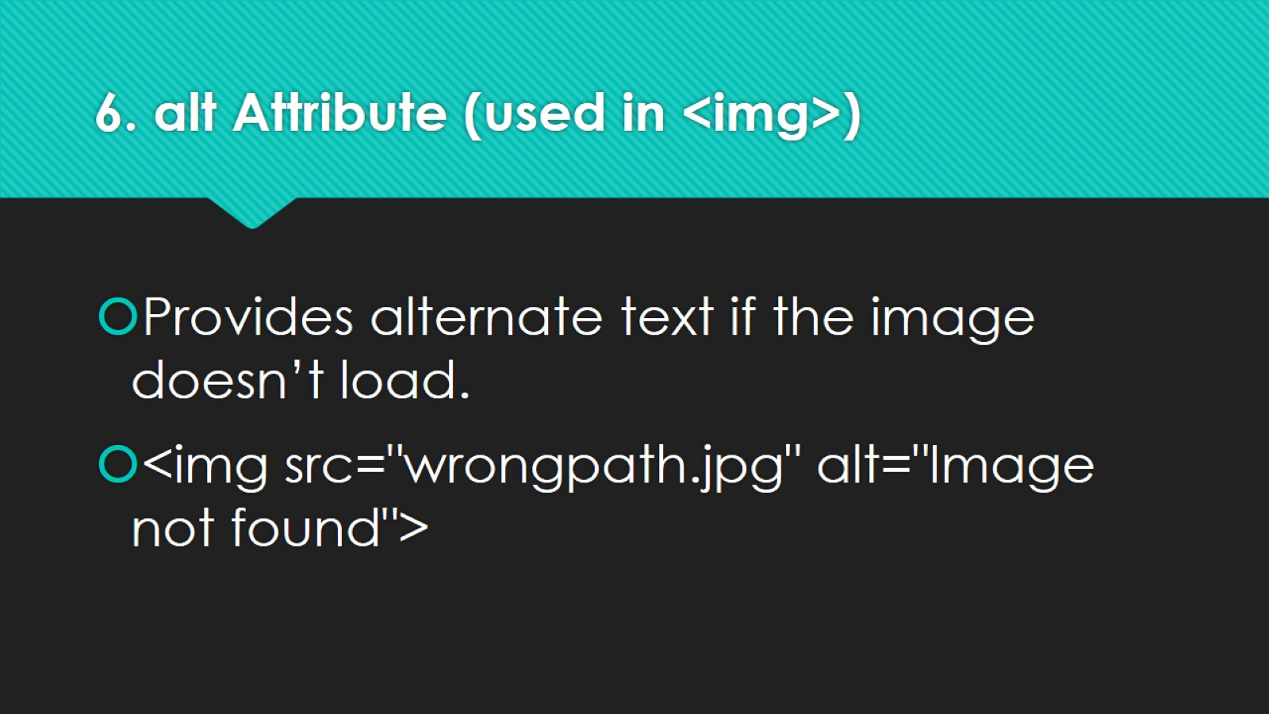
6. alt Attribute (used in <img>)

Slide 20
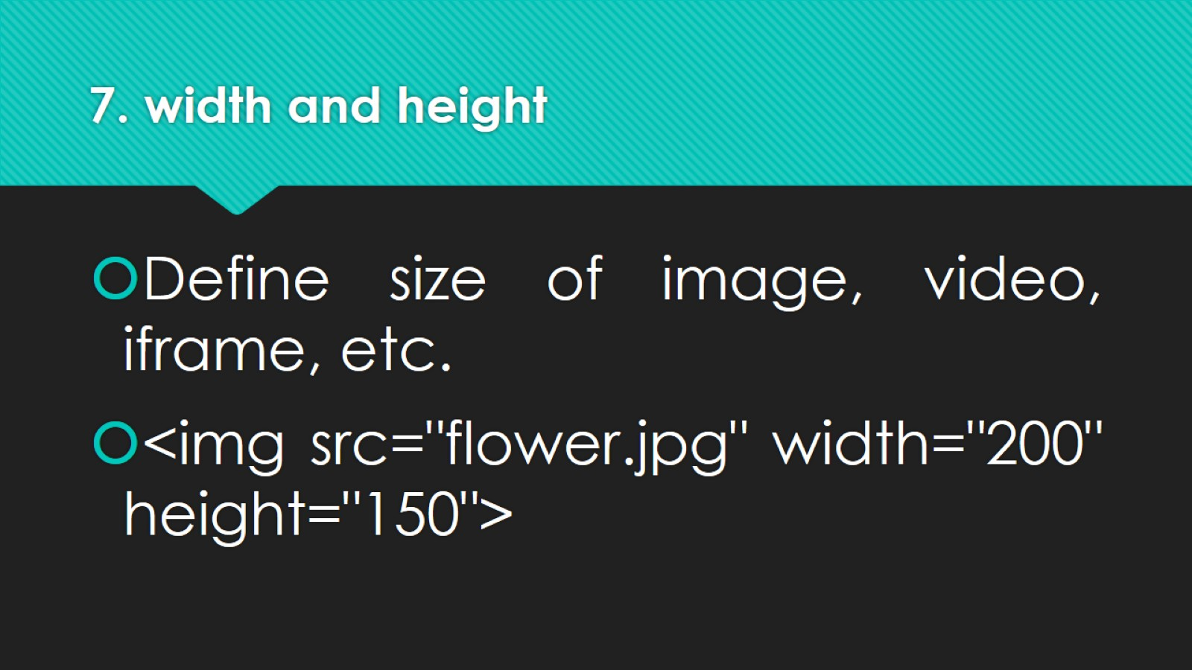
7. width and height

Slide 21
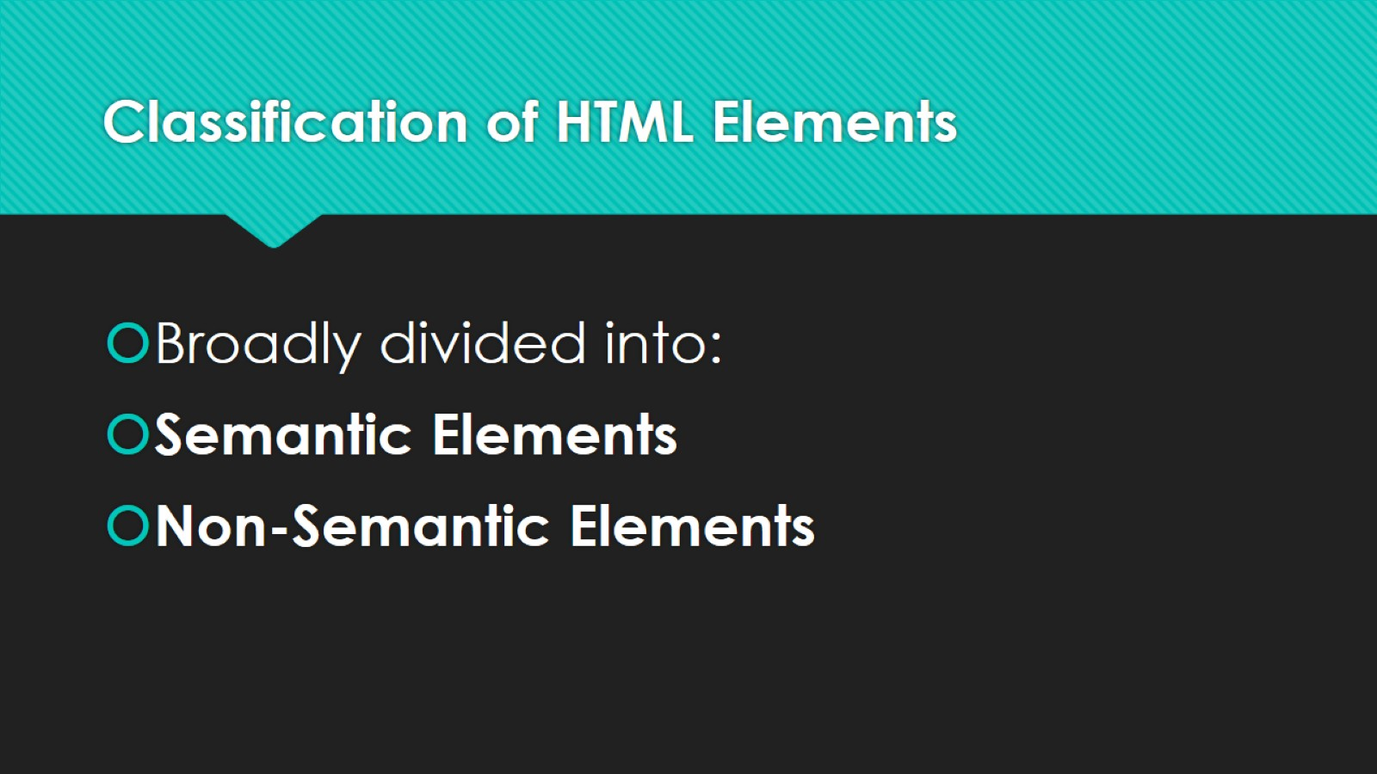
Classification of HTML Elements

Slide 22
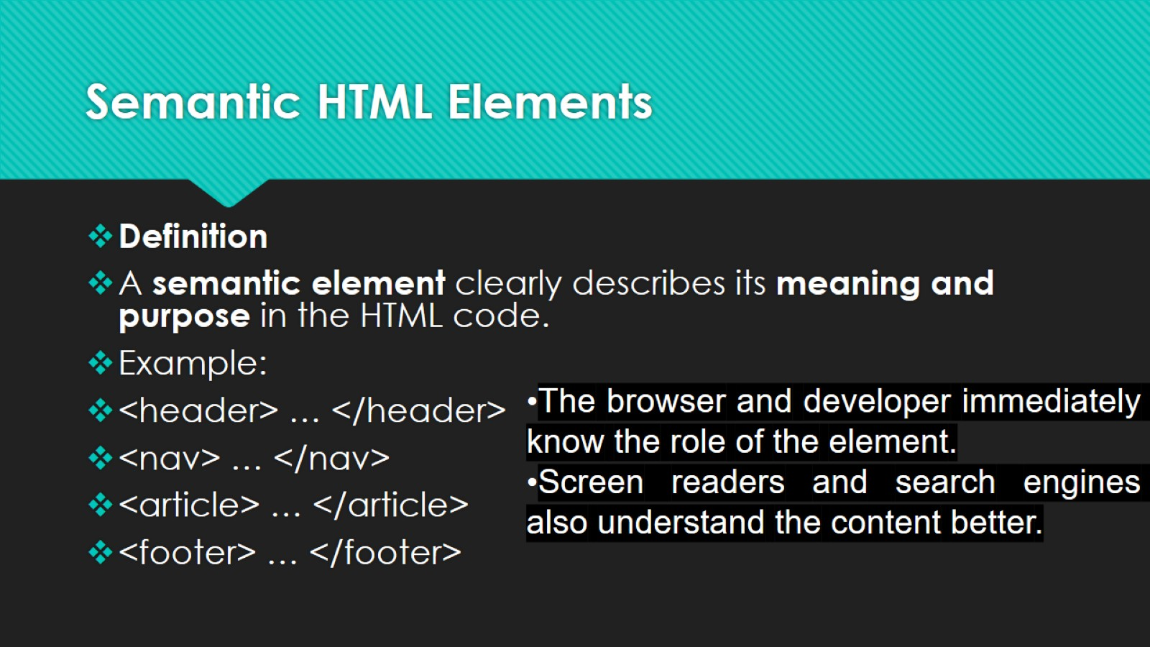
Semantic HTML Elements

Slide 23
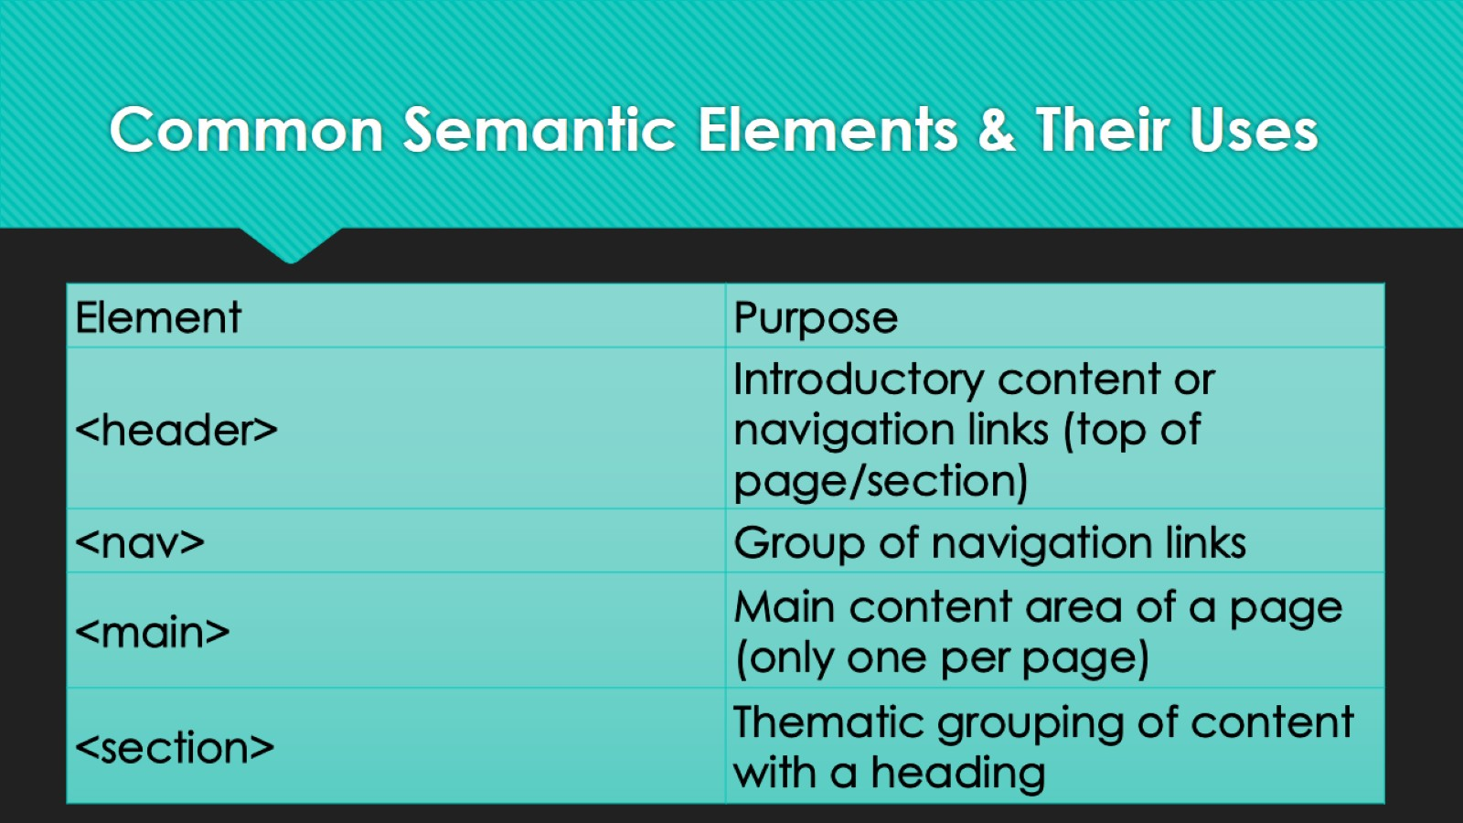
Common Semantic Elements & Their Uses

Slide 24
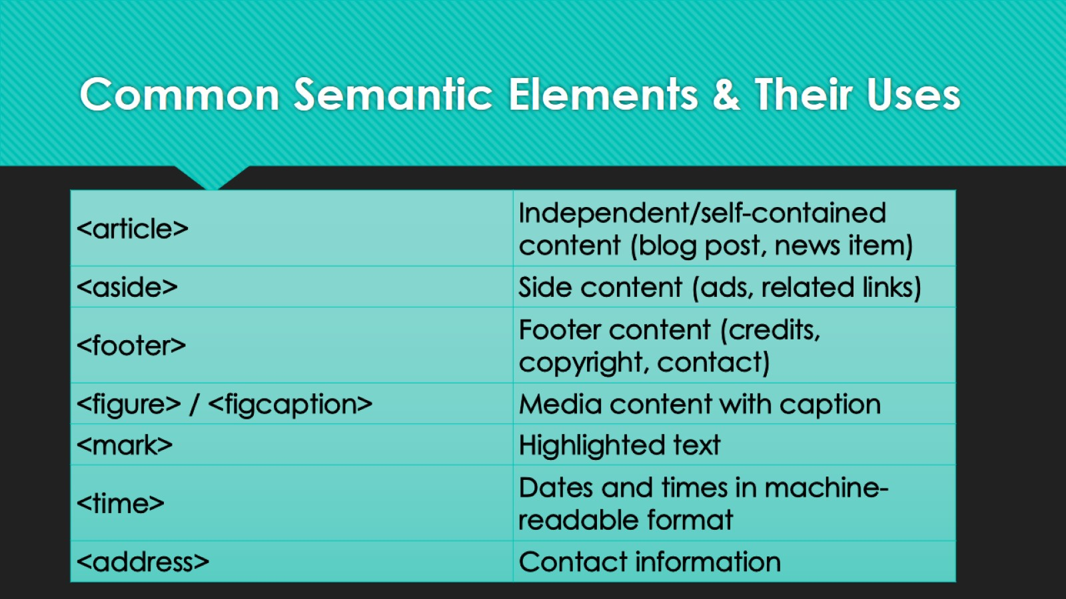
Common Semantic Elements & Their Uses

Slide 25
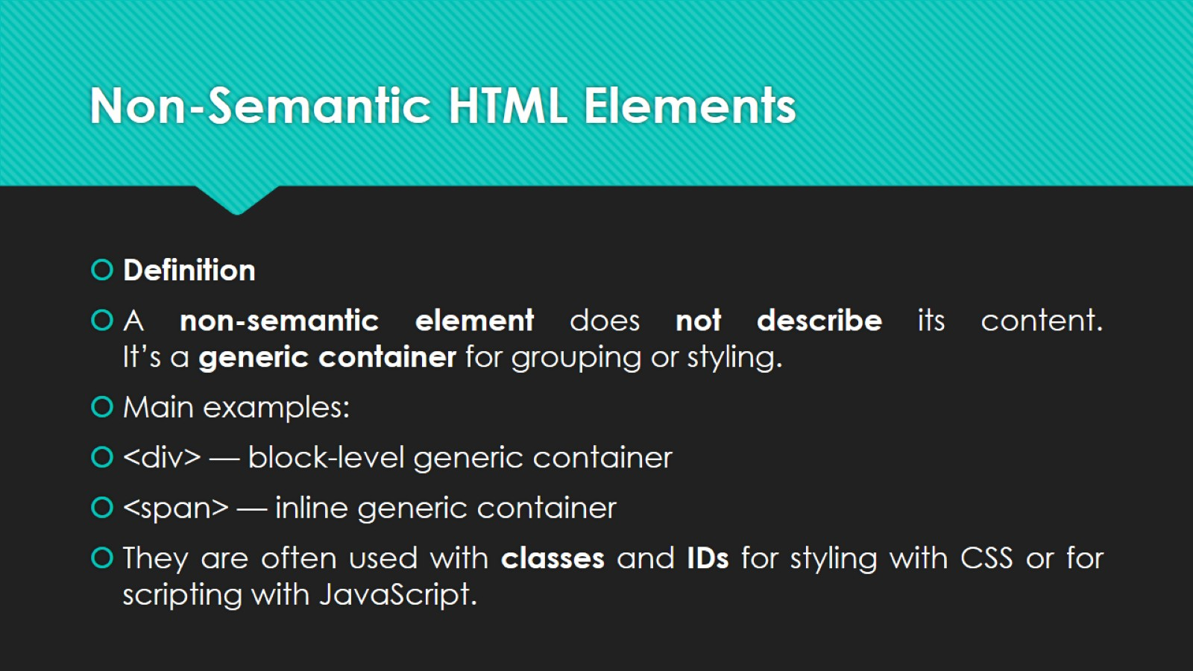
Non-Semantic HTML Elements

Slide 26
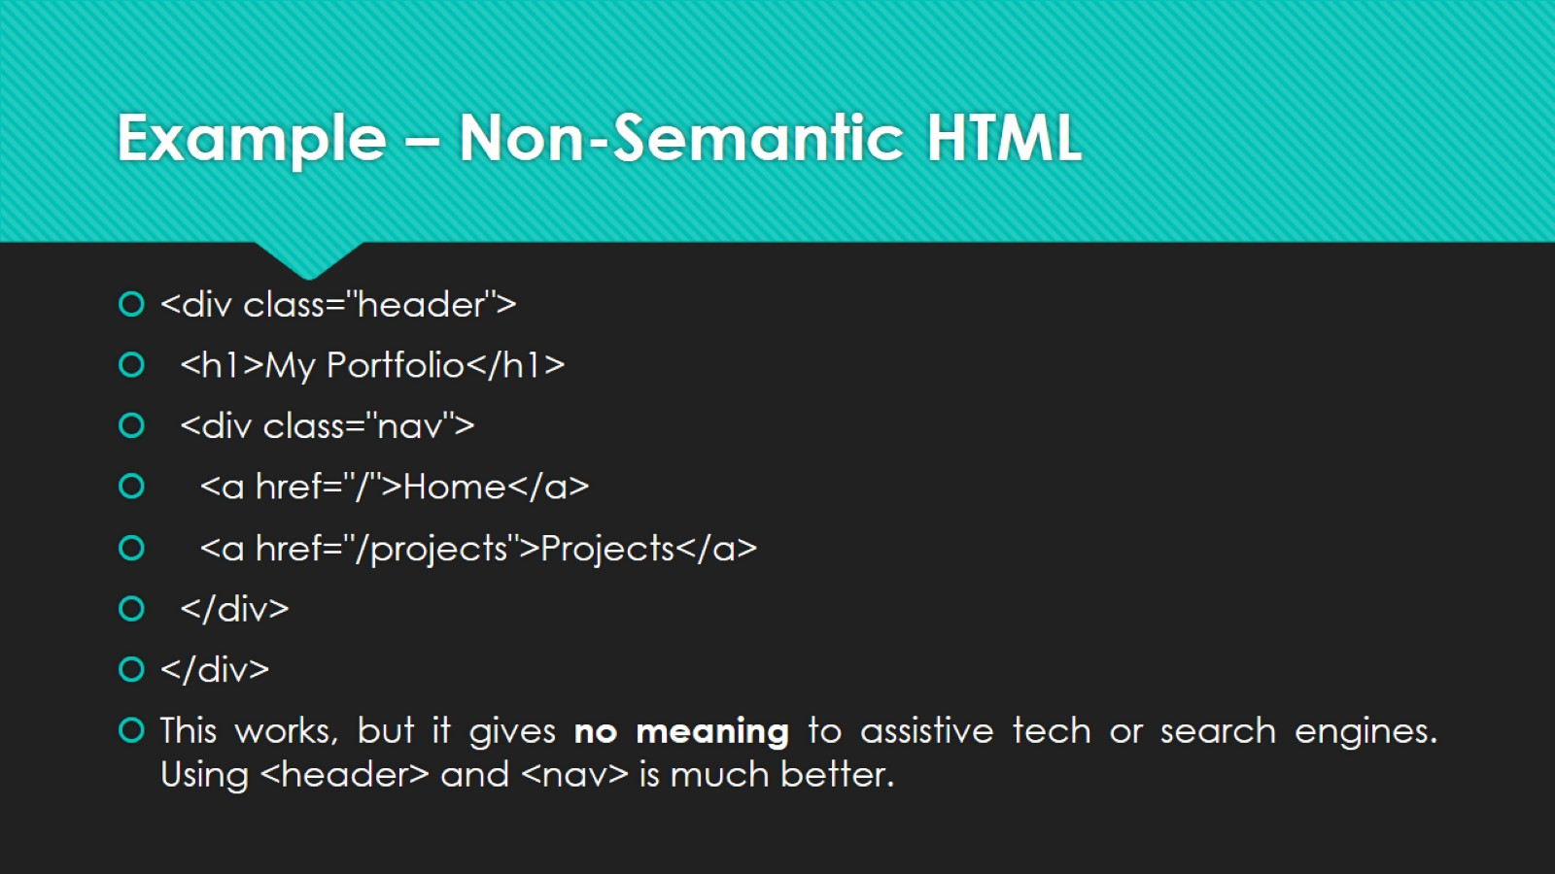
Example – Non-Semantic HTML

Slide 27
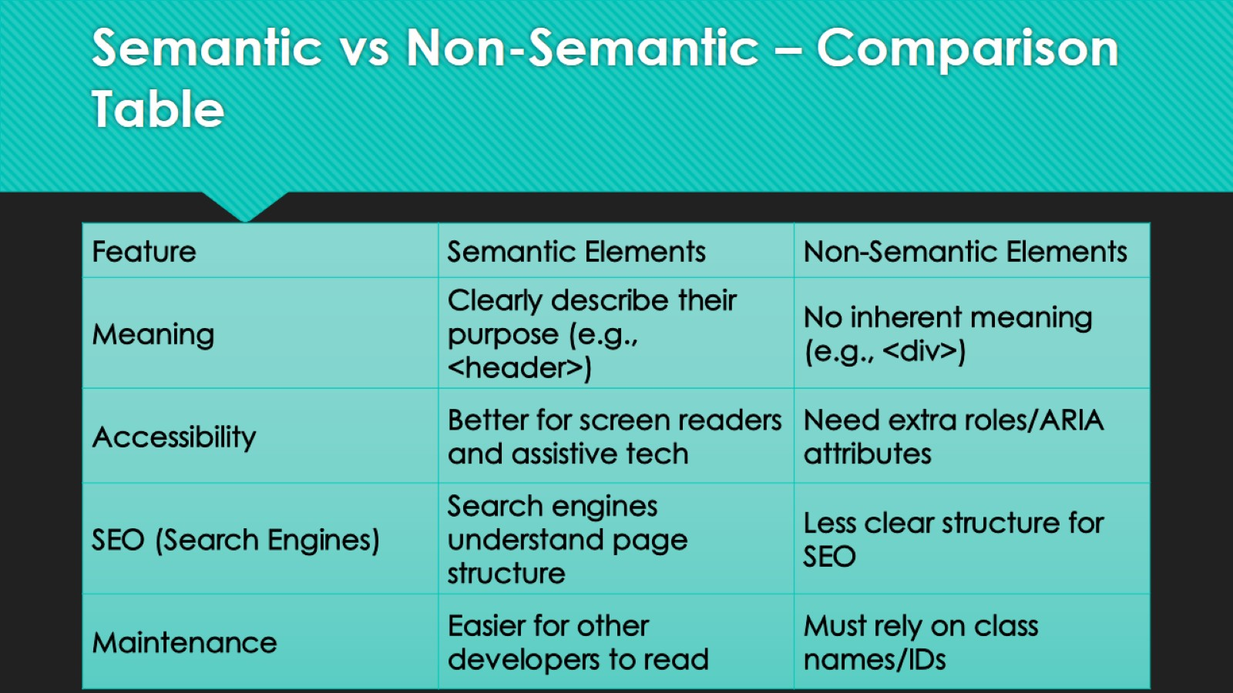
Semantic vs Non-Semantic – Comparison Table

Slide 28
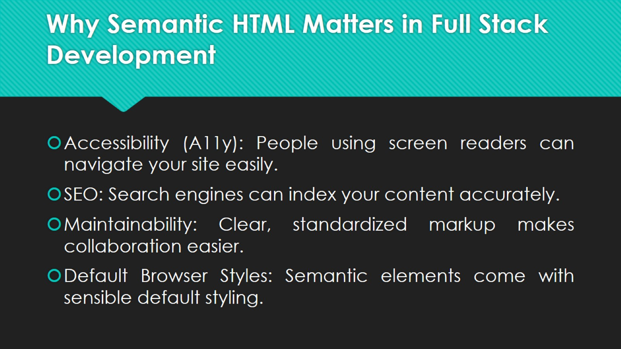
Why Semantic HTML Matters in Full Stack Development

Slide 29
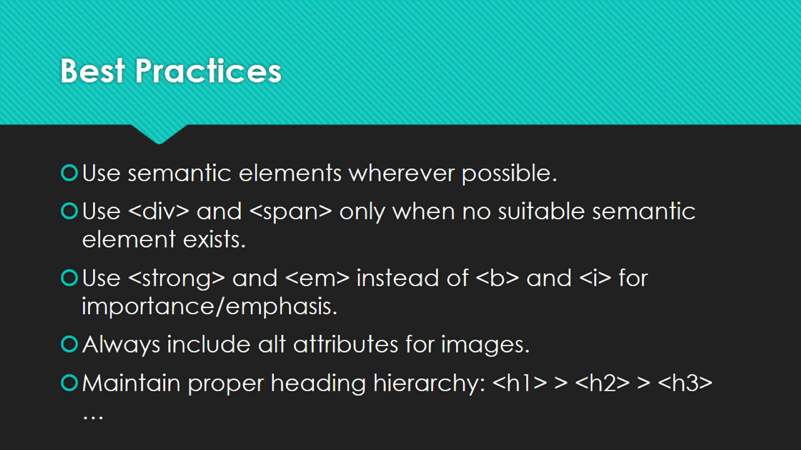
Best Practices

Slide 30
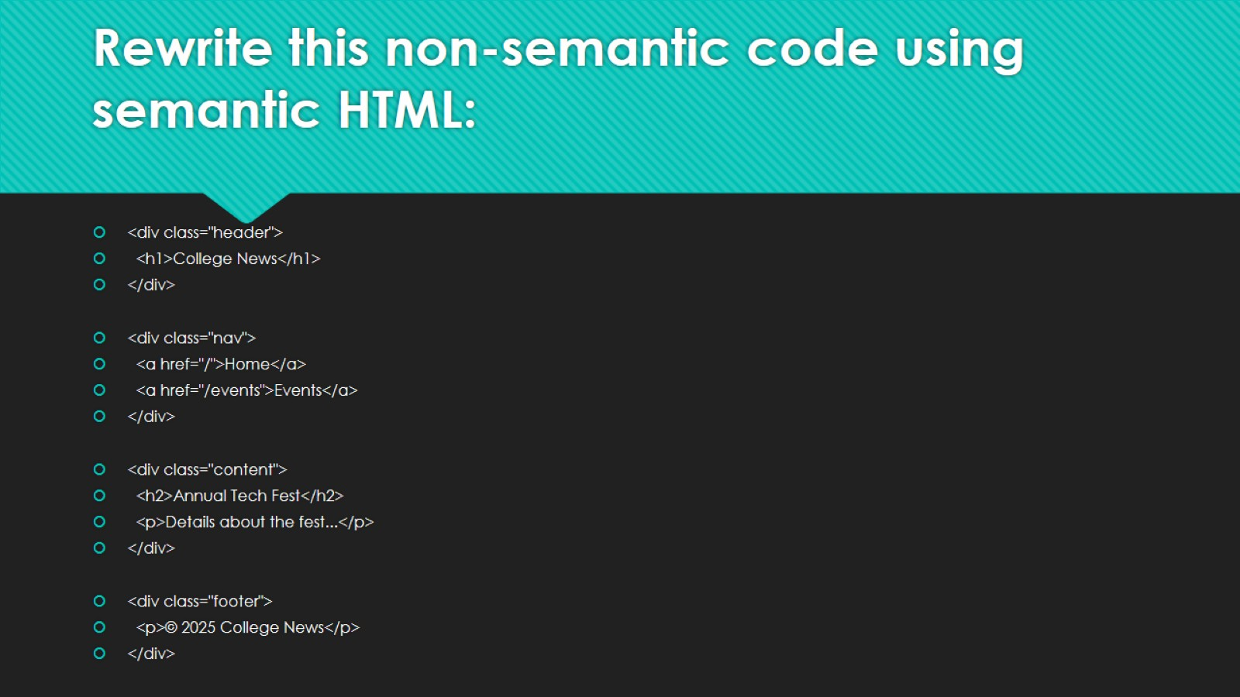
Rewrite this non-semantic code using semantic HTML:

Slide 31

Solution

Slide 32
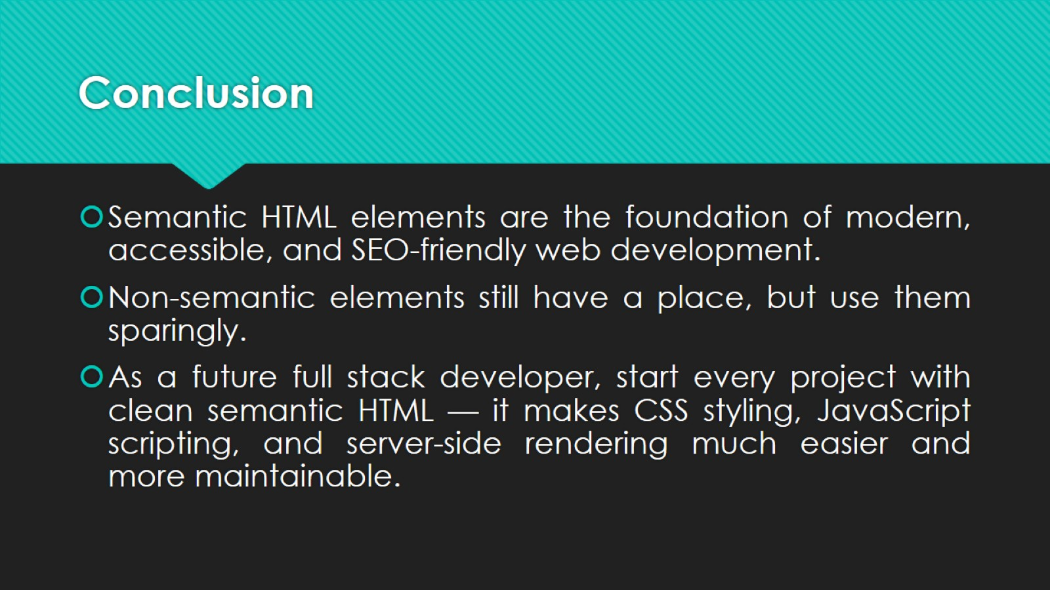
Conclusion

Slide 33
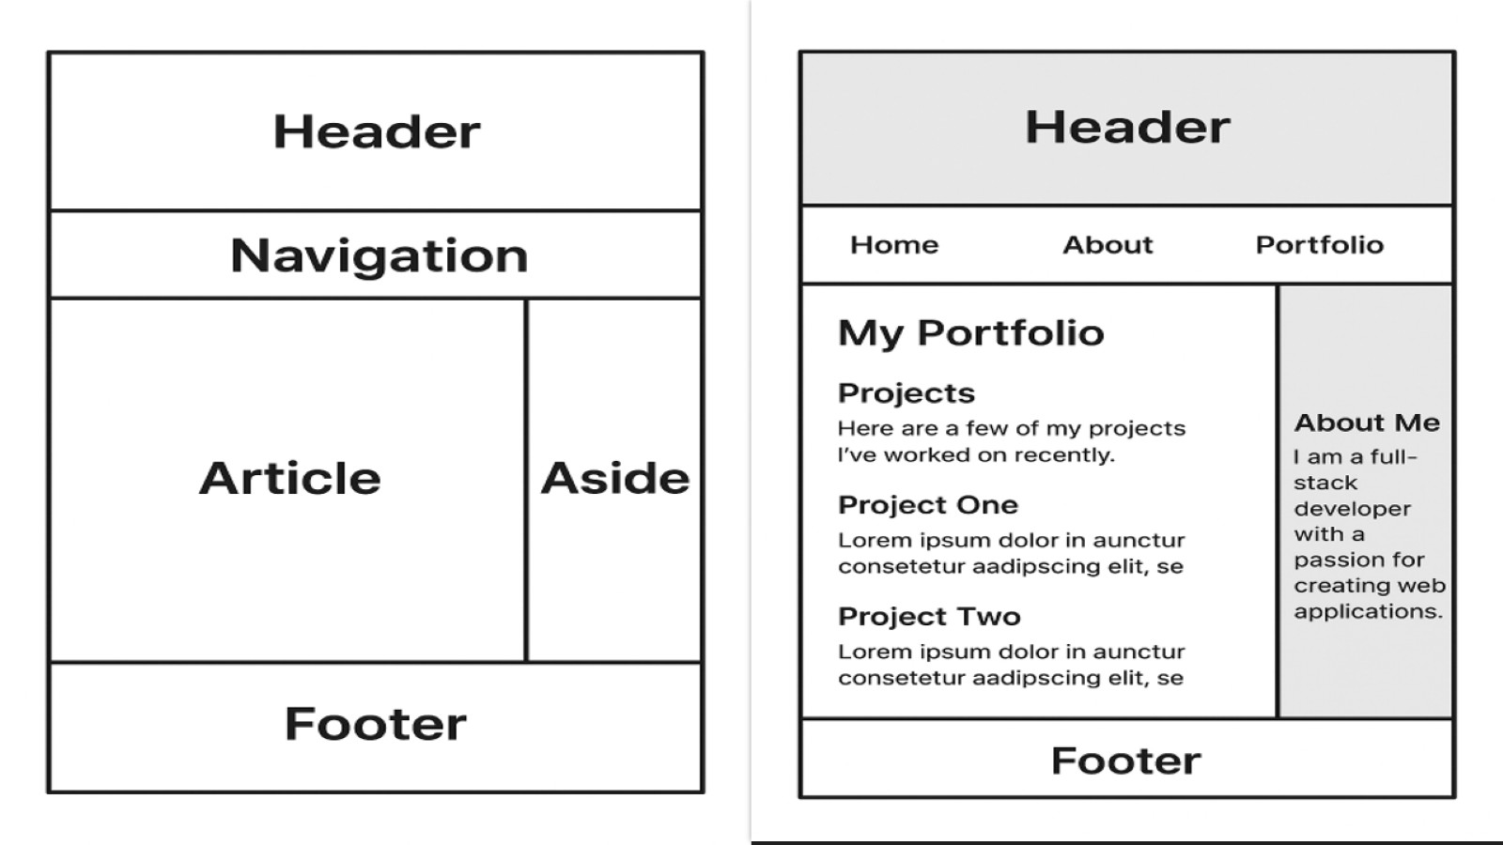

Slide 34

HTML Elements & Text Formatting

Slide 35
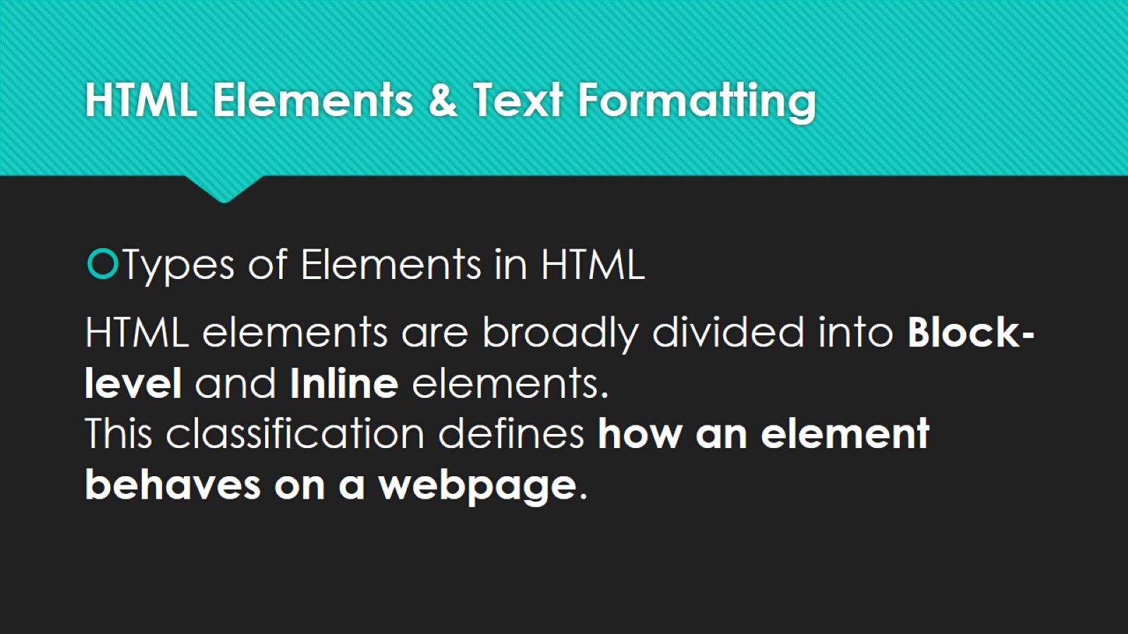
HTML Elements & Text Formatting

Slide 36
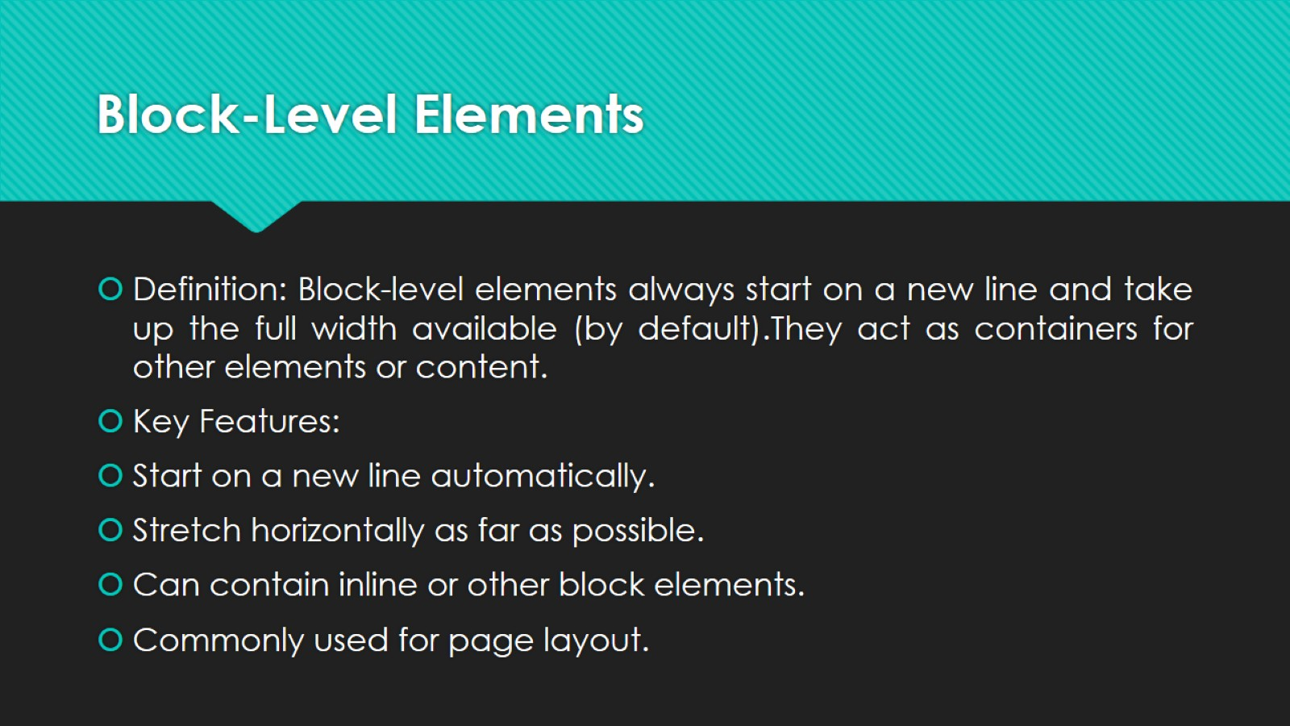
Block-Level Elements

Slide 37
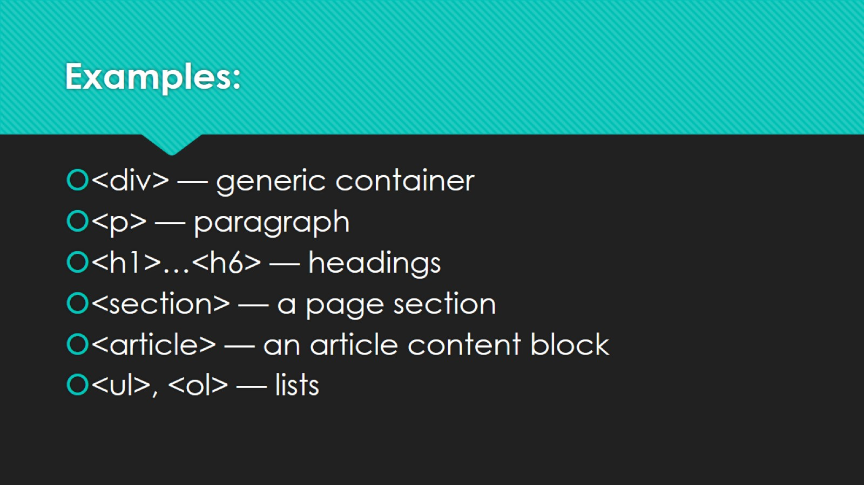
Examples:

Slide 38
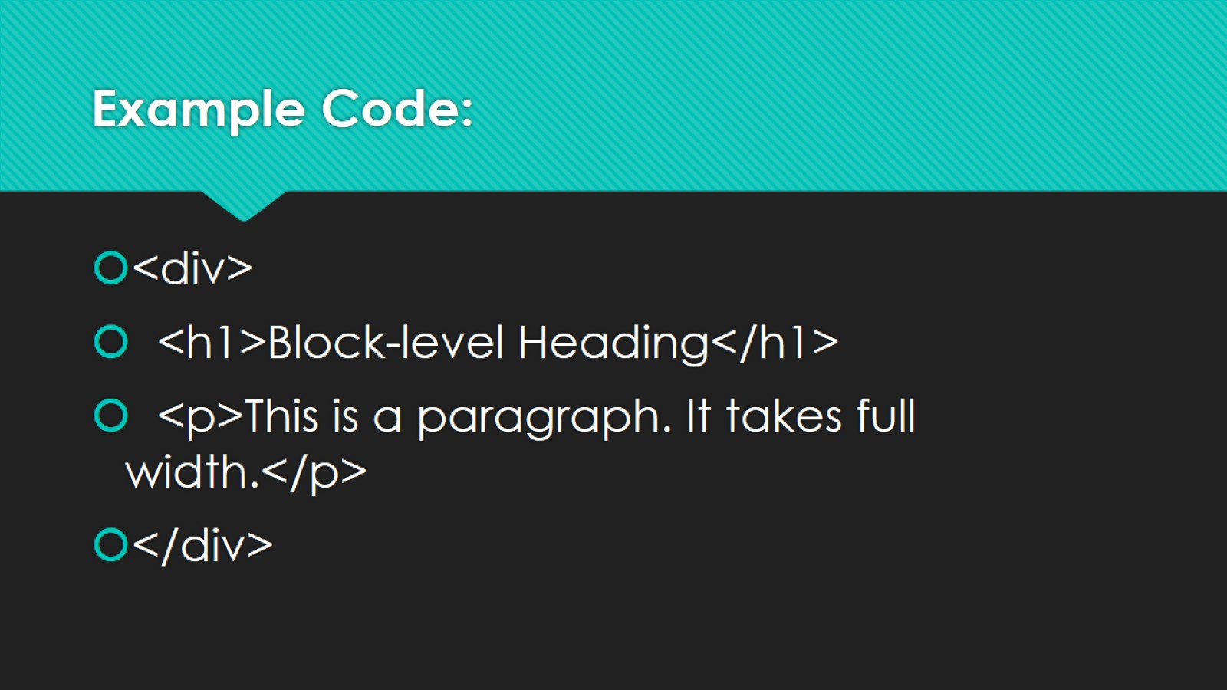
Example Code:

Slide 39
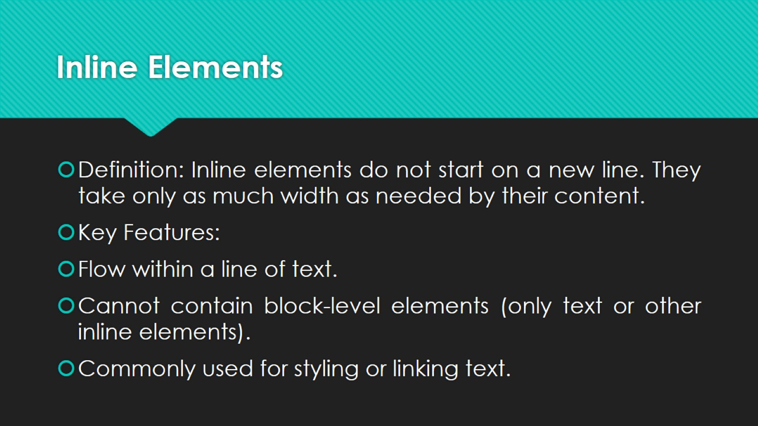
Inline Elements

Slide 40
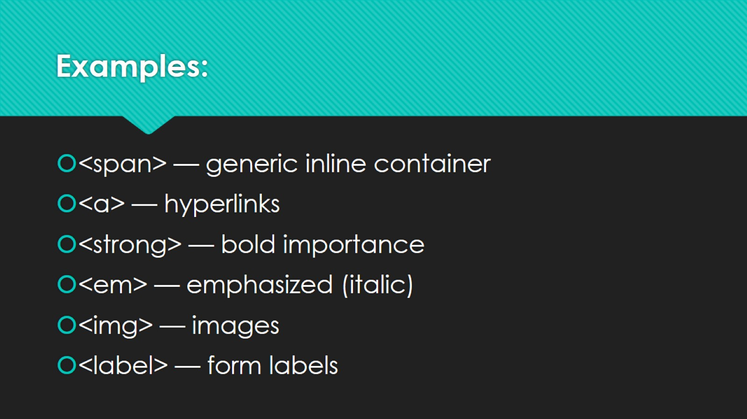
Examples:

Slide 41
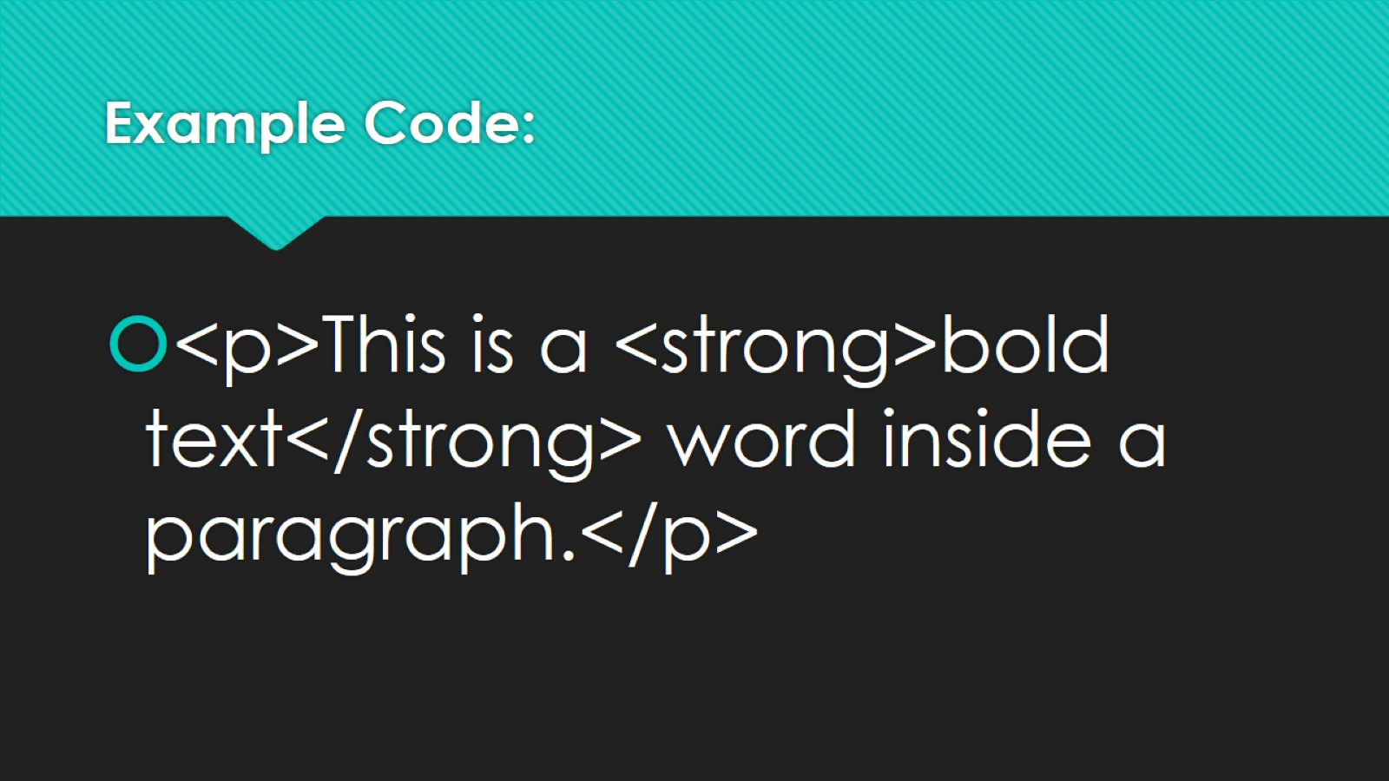
Example Code:

Slide 42
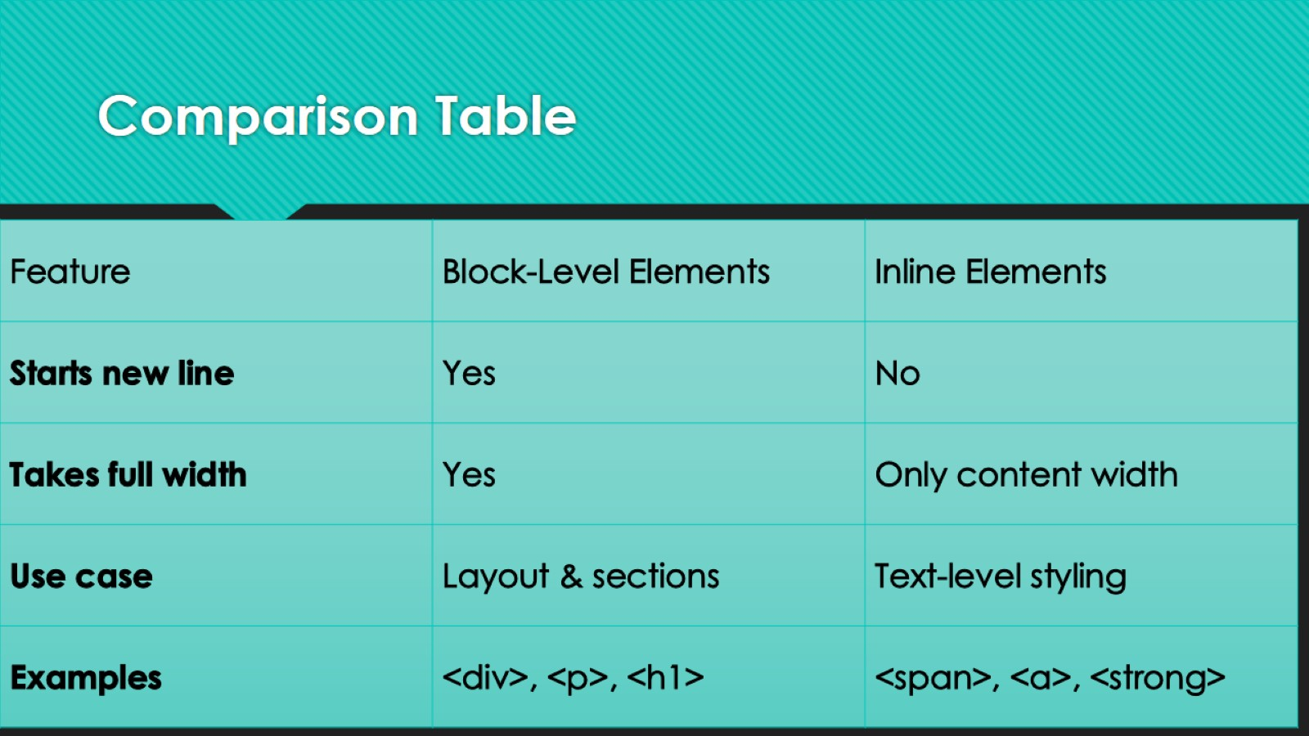
Comparison Table

Slide 43
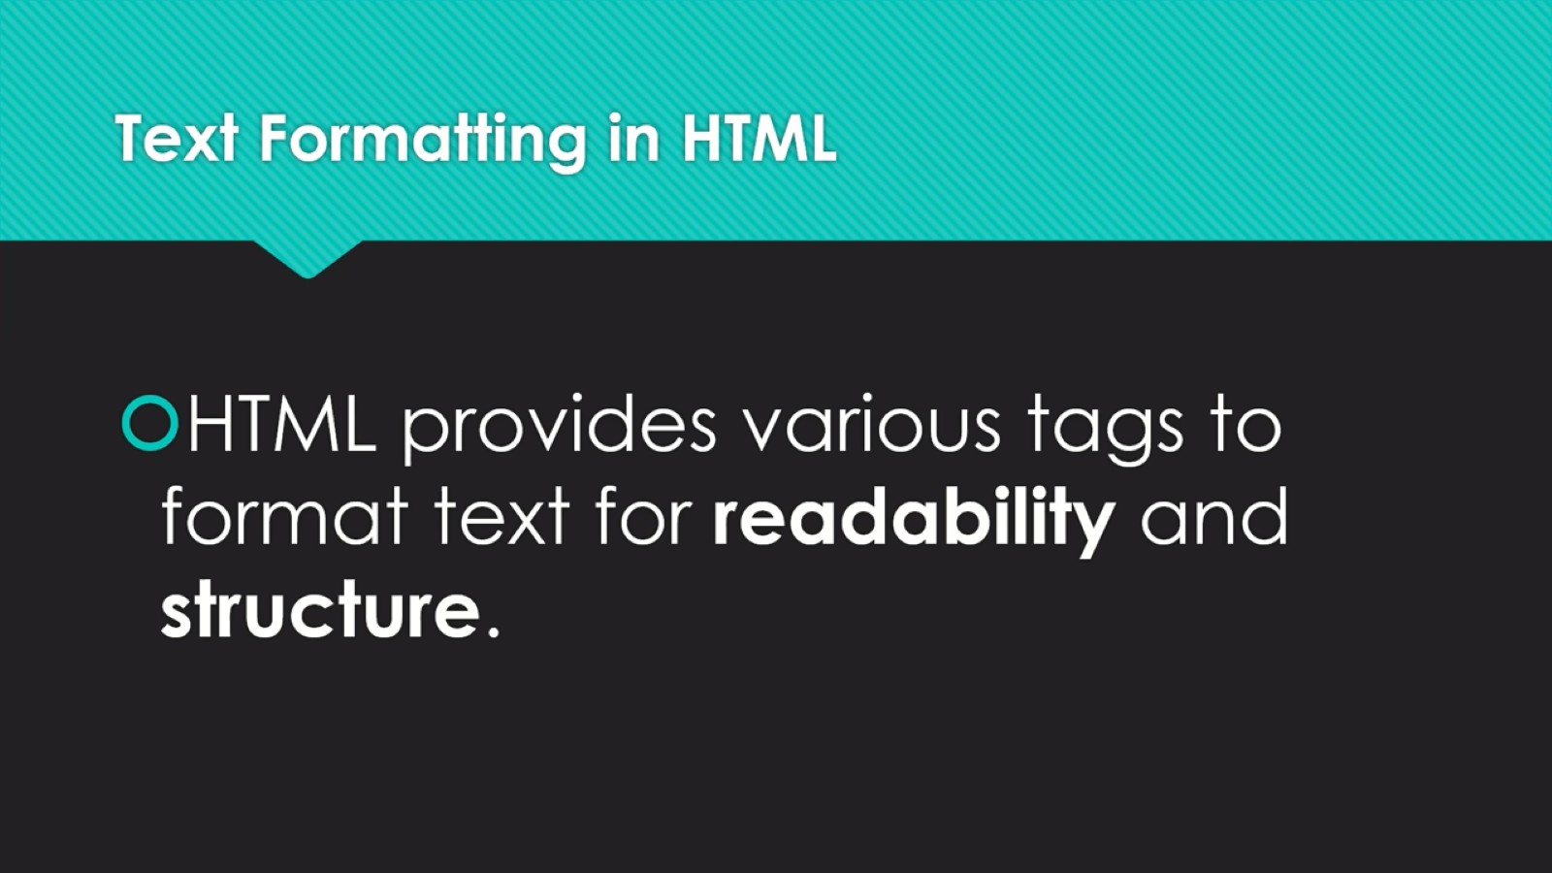
Text Formatting in HTML

Slide 44
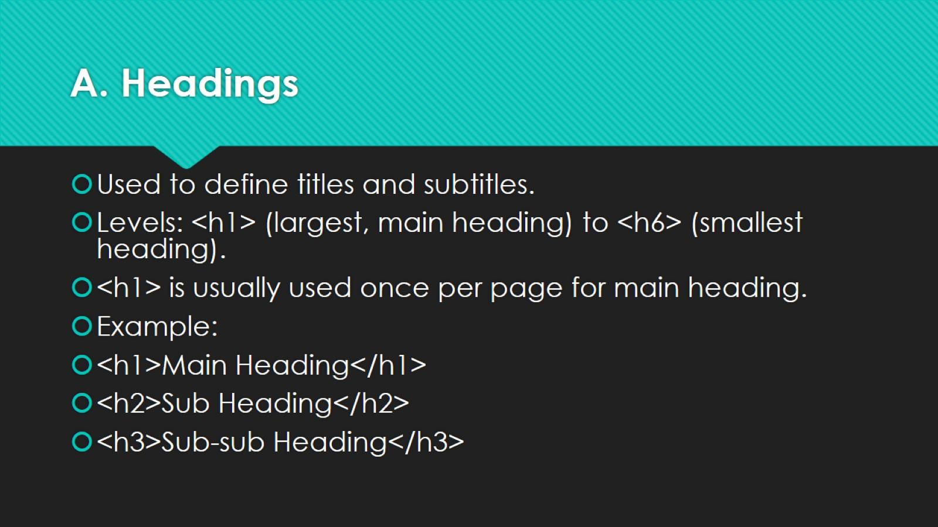
A. Headings

Slide 45
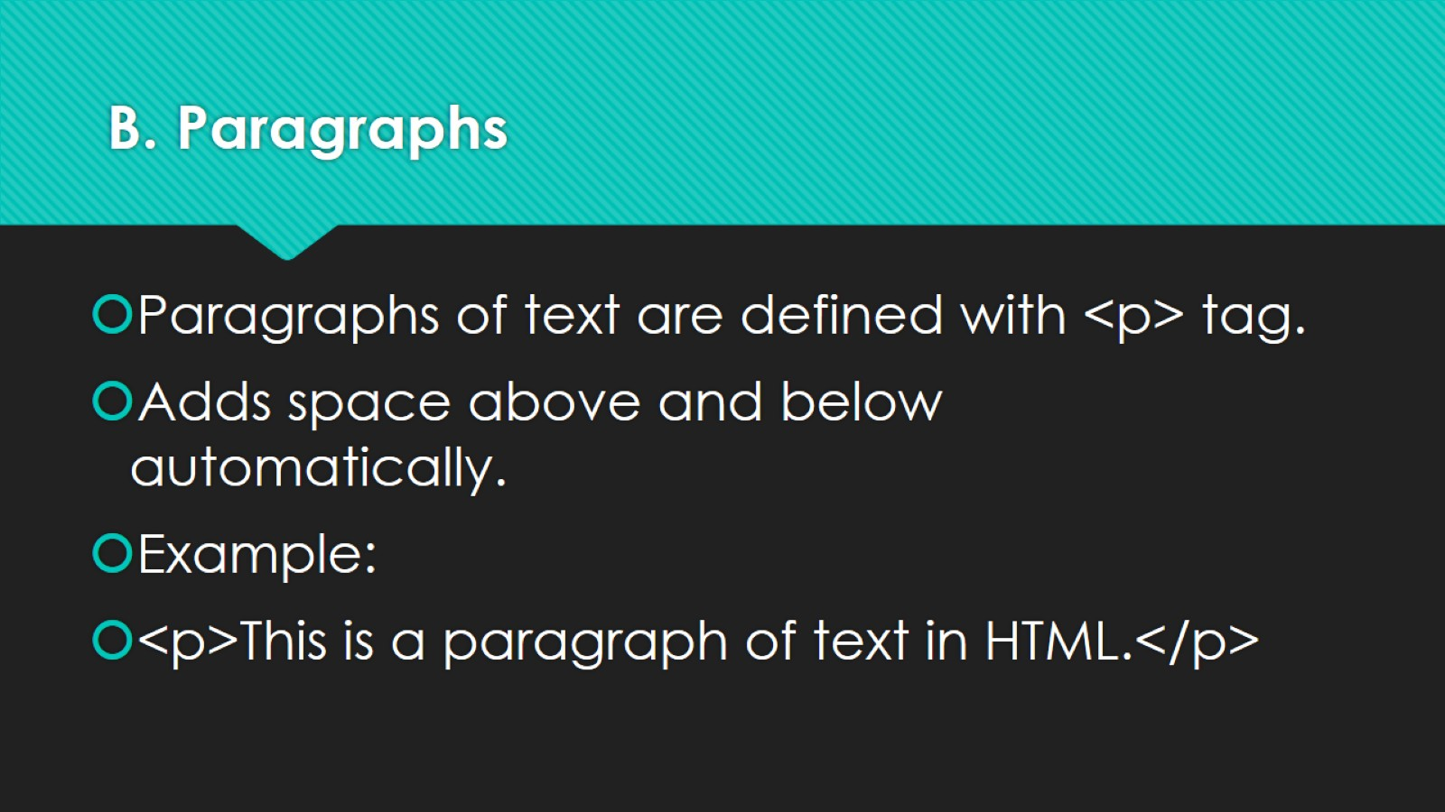
B. Paragraphs

Slide 46
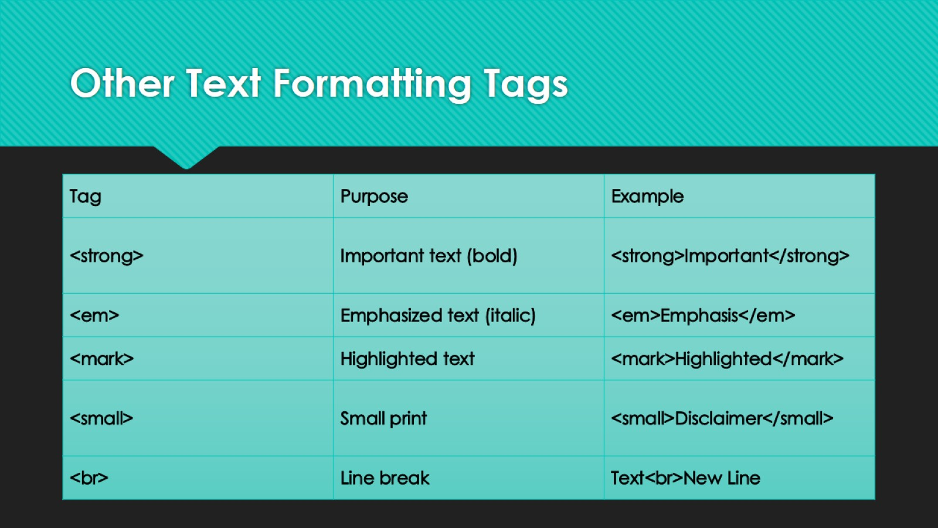
Other Text Formatting Tags

Slide 47
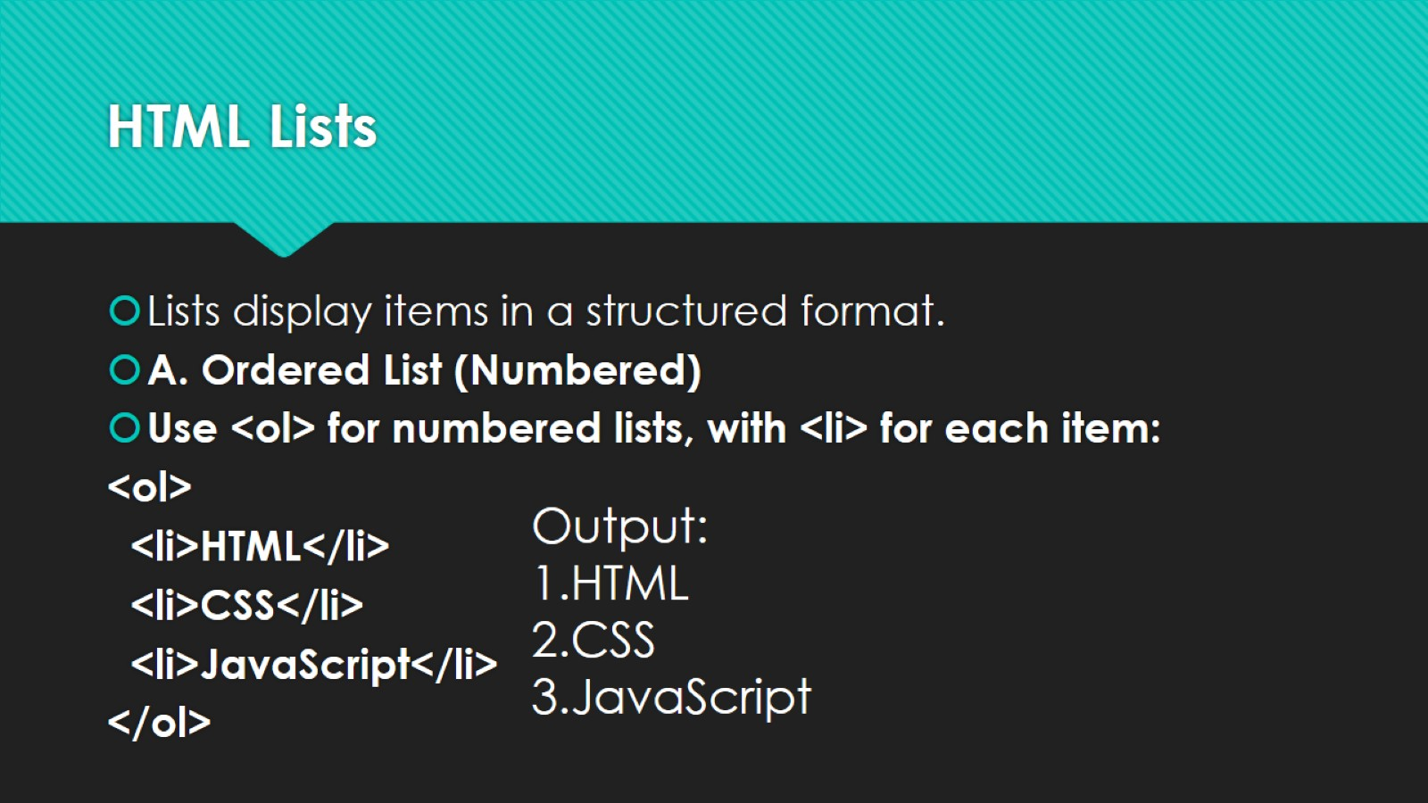
HTML Lists

Slide 48
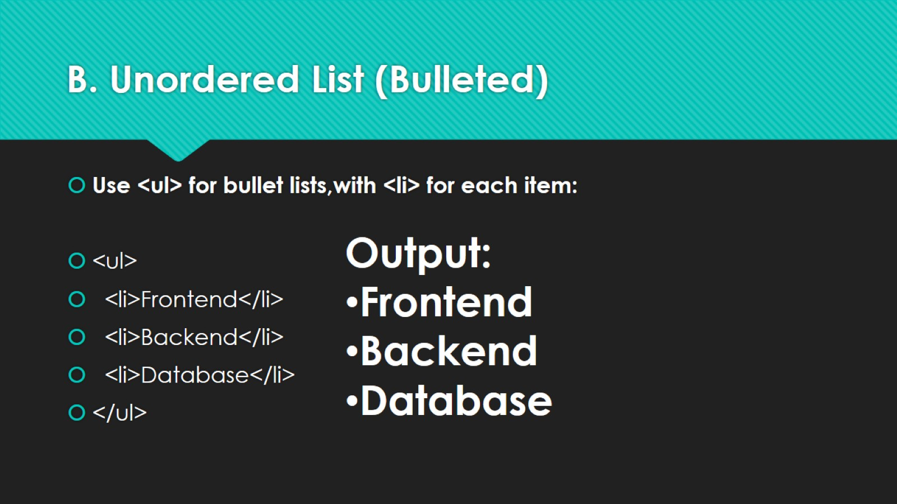
B. Unordered List (Bulleted)

Slide 49
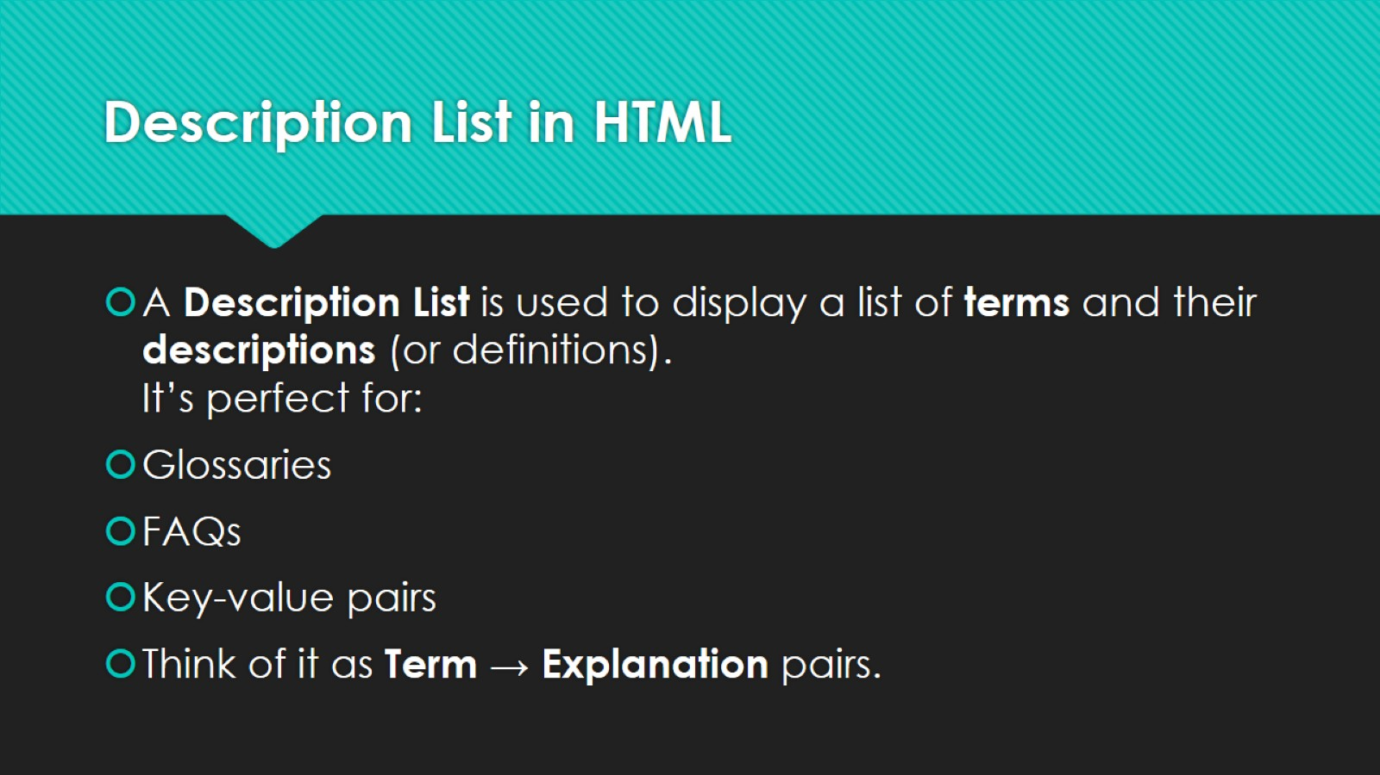
Description List in HTML

Slide 50
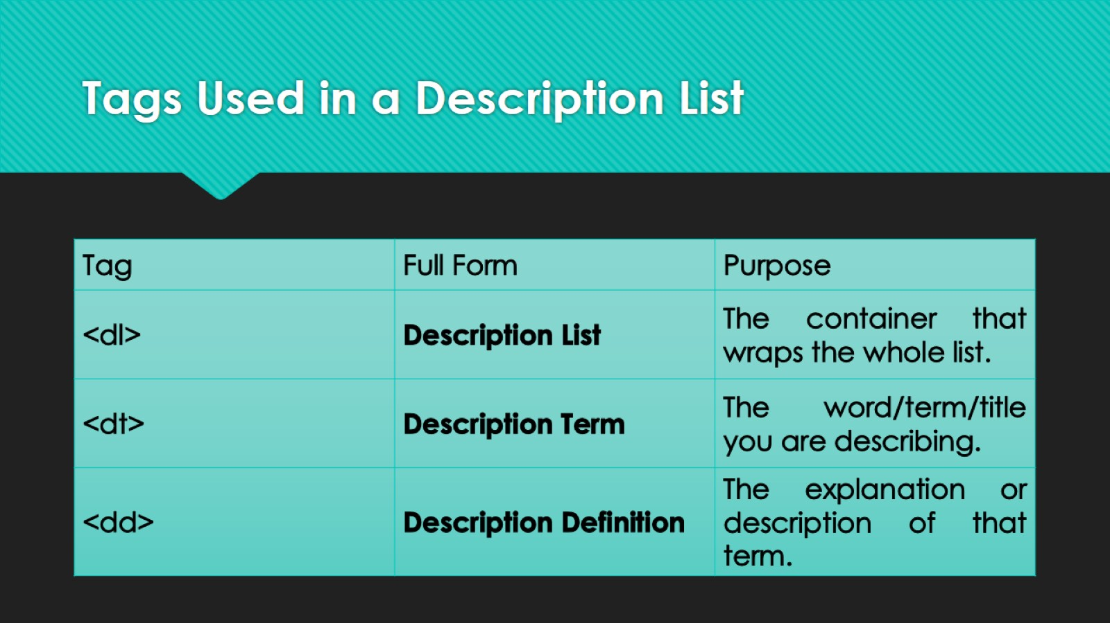
Tags Used in a Description List

Slide 51
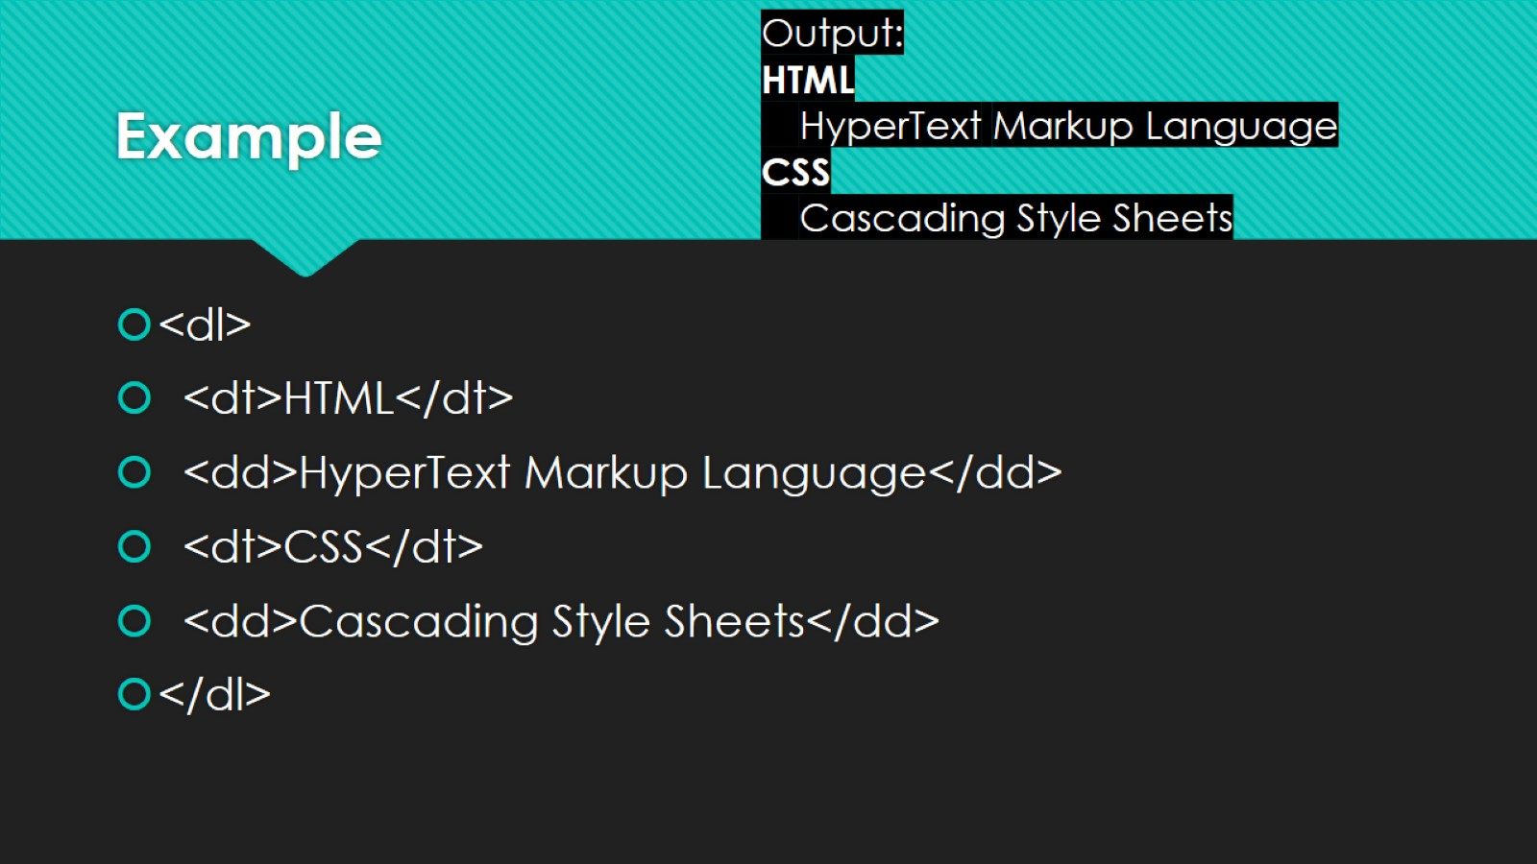
Example

Slide 52
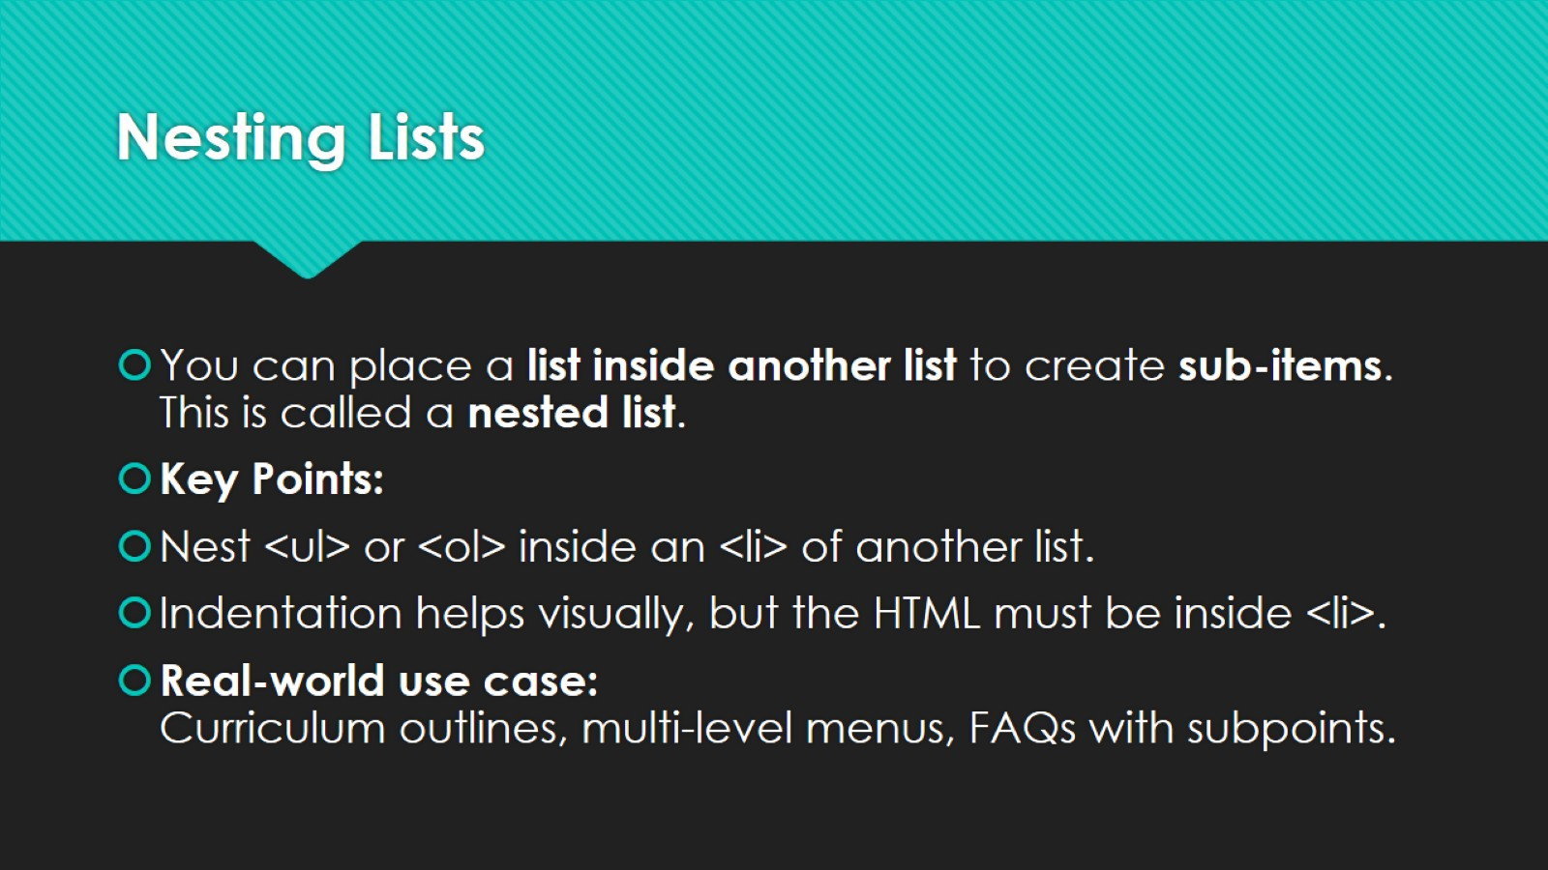
Nesting Lists

Slide 53
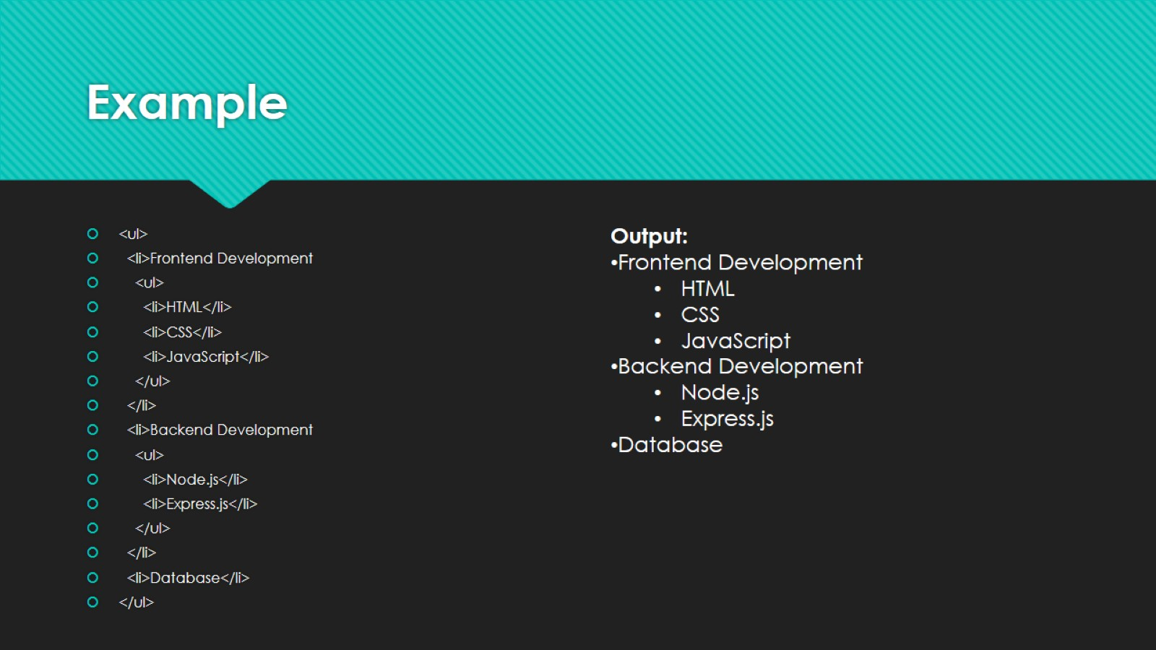
Example

Slide 54
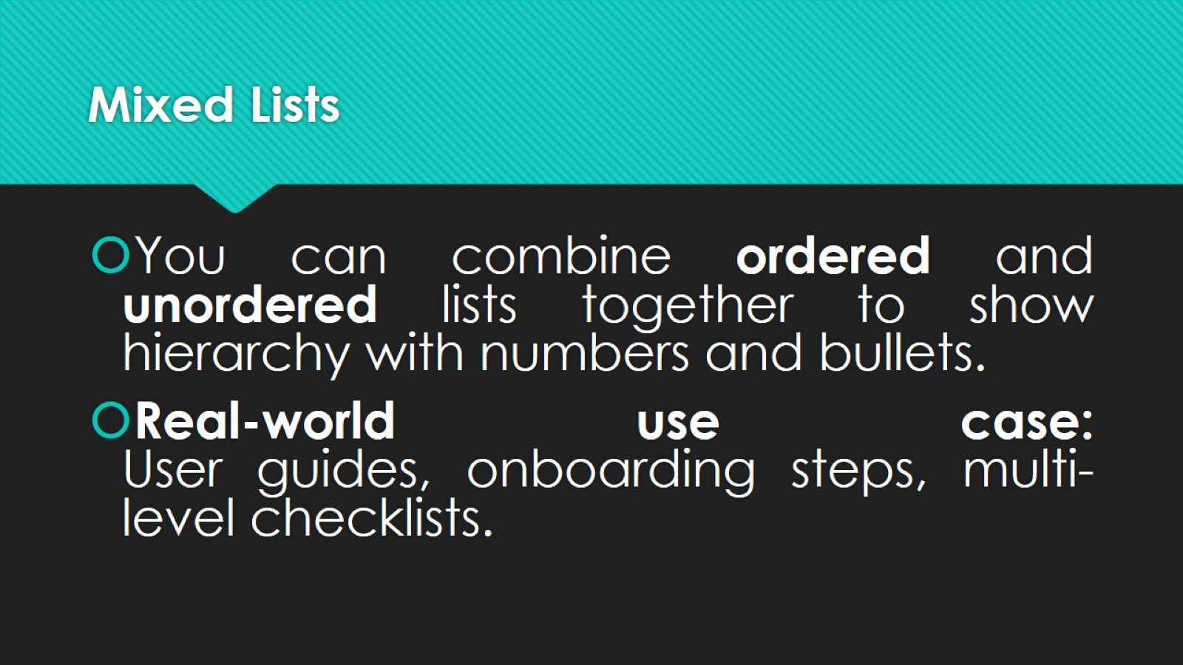
Mixed Lists

Slide 55

Example — Step-by-Step Process with Subtasks:

Slide 56

Lists for Navigation Menus

Slide 57

Basic Navigation Menu Example

Slide 58

Nested Navigation Menu Example (Dropdown)

Slide 59

Key Takeaways

Slide 60

HTML — Links, Images & Attributes, Comments, Formatting Elements & Special Characters

Slide 61

HTML Links and Anchor Tag Attributes

Slide 62

HTML Links (<a>)

Slide 63

Common attributes

Slide 64

Images (<img>) and Image Attributes

Slide 65

Important attributes

Slide 66

Comments in HTML

Slide 67

HTML Formatting Elements (text-level semantics)

Slide 68

Special Characters & Symbols (HTML entities)

Slide 69

Commonly Used HTML Entities

Slide 70

Text-Related Elements: Quotation & Citation

Slide 71

HTML Multimedia & Hyperlinks

Slide 72

A) Images in HTML

Slide 73

B) Video in HTML

Slide 74

Audio in HTML

Slide 75

D) Embedding YouTube Video

Slide 76

HTML Forms

Slide 77

What is a Form in HTML?

Slide 78

Basic Structure of a Form

Slide 79

Attributes of <form>:

Slide 80

Form Elements

Slide 81

Form Elements

Slide 82

Form Elements

Slide 83

Form Elements

Slide 84

Form Elements

Slide 85

Form Elements

Slide 86

Form Elements

Slide 87

Form Elements

Slide 88

Form Elements

Slide 89

Form Elements

Slide 90

HTML Tables

Slide 91

What is a Table in HTML?

Slide 92

Basic Structure of a Table

Slide 93

Adding Table Headings

Slide 94

Table Attributes

Slide 95
Attribute | Description | Example
border | Sets border thickness | <table border="1">
cellpadding | Space inside cells | <table cellpadding="10">
cellspacing | Space between cells | <table cellspacing="5">
width | Defines width | <table width="80%">
align | Aligns table | <table align="center">
bgcolor | Background color | <table bgcolor="lightyellow">

Slide 96

Rowspan & Colspan (Merging Cells)

Slide 97

Table with Caption

Slide 98
What is a Responsive Table?
A responsive table means a table that automatically adjusts its layout to fit different screen sizes — for example, it looks good on both:
a desktop (large screen), and
a mobile (small screen).
Normally, CSS media queries are used to make it responsive.

Slide 99
What is a Responsive Table?
Normally, CSS media queries are used to make it.
“without CSS”, we can still make it partially responsive using:
HTML attributes like width="100%",
scrolling inside a container (<div> with overflow property—though minimal CSS is needed for scroll),
or by making the table auto-adjustable to screen width.
However, a fully responsive table without any CSS is not possible, but we can make a basic responsive-like behavior using pure HTML.

Slide 100
Code Explanation
1. <div style="overflow-x:auto;">
It allows the table to scroll horizontally if the screen is small (like mobile).
This is the simplest way to make a table scrollable without advanced CSS.
So, instead of shrinking or hiding columns, the user can scroll left-right on small screens.
2. <table border="1" width="100%">
The width="100%" makes the table stretch to the available screen width.
The border="1" adds visible cell borders (helps identify cells).

Slide 101

Nested Tables in HTML (Table inside a Table)
A nested table means placing one table inside another table’s <td> cell. It helps to organize complex data — for example, a student record table where each student’s “marks” are another mini-table.

